Slide 1
Lesson: _____ Section 2.6, 2.7 Graphs of Rational Functions
No note taking, just show, then give the handout at end.
DOMINANCE !
0
As x becomes extremely large (x → ∞), which term will dominate?

Slide 2
DOMINANCE !
0
As x becomes extremely large (x → ∞), what will f(x) approach?

Slide 3
Rational Functions
are a ratio of two polynomial expressions
Ex. Sketch the graph of the rational function

Slide 4
Understanding Fractions
What happens to f(x) if p = 0?
What happens to f(x) if q = 0?

Slide 5
GRAPHING RATIONAL FUNCTIONS
CONCEPT
GRAPHS OF RATIONAL FUNCTIONS
SUMMARY
Let p (x ) and q (x ) be polynomials with no common factors other
than 1.The graph of the rational function
p (x )
q (x )
a _{m} x ^{m} + a _{m – 1}x ^{m – 1} + … + a ₁x + a ₀
f (x ) = =
b _{n} x ^{n} + b _{n – 1}x ^{n – 1} + … + b ₁x + b ₀
has the following characteristics.
1. x - intercepts are the real zeros of p (x )
2. vertical asymptote at each real zero of q (x )
3. at most one horizontal asymptote

Slide 6
GRAPHING RATIONAL FUNCTIONS
CONCEPT
GRAPHS OF RATIONAL FUNCTIONS
SUMMARY
p (x )
q (x )
a _{m} x ^{m} + a _{m – 1}x ^{m – 1} + … + a ₁x + a ₀
f (x ) = =
b _{n} x ^{n} + b _{n – 1}x ^{n – 1} + … + b ₁x + b ₀
3. at most one horizontal asymptote at each zero of q (x )
• If m < n, the line y = 0 is a horizontal asymptote.
a _{m}
b _{n}
• If m = n, the line y = is a horizontal asymptote.
• If m > n, the graph has no horizontal asymptote.

Slide 7
DOMINANCE !
As x becomes extremely large (x → ∞), who will dominate the fraction, the numerator or the denominator?
As x becomes extremely large (x → ∞), what will f(x) approach?

Slide 8
DOMINANCE !
3x² - 4x + 3

Slide 9
DOMINANCE !

Slide 10
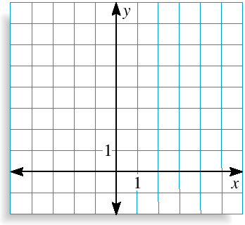
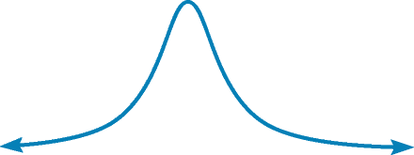
Graphing a Rational Function (m < n)
4
x ² + 1
State domain
and range.
Graph y = .
SOLUTION
The numerator has no zeros, so there
is no x-intercept.
The denominator has no real zeros, so there is no vertical asymptote.
The degree of the numerator (0) is less than the degree of the
denominator (2), so the line y = 0 (the x-axis) is a horizontal asymptote.
The bell-shaped graph passes through (–3, 0.4), (– 1, 2), (0, 4), (1,2),
and (3, 0.4). The domain is all real numbers; the range is 0 < y ≤ 4.

Slide 11
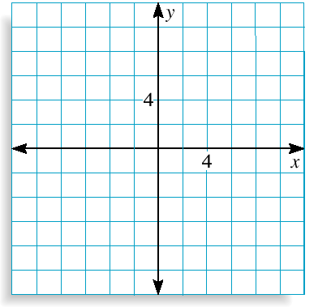
Graphing a Rational Function (m = n)
3x ²
x ² – 4
Graph y = .
SOLUTION
The numerator has 0 as its only zero, so the graph has one x-intercept at (0, 0).
The denominator can be factored as (x + 2)(x – 2), so the denominator has zeros at 2 and – 2. This implies vertical
asymptotes at x = – 2 and x = 2.
The degree of the numerator (2) is equal to the degree of the denominator (2),
so the horizontal asymptote is y = = 3.
a_{m}
b_{n}

Slide 12
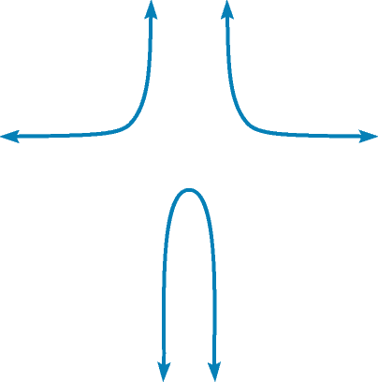
Graphing a Rational Function (m = n)
3x ²
x ² – 4
Graph y = .
To draw the graph, plot points between
and beyond vertical asymptotes.
x
y
x
y
To the left of
x = – 2
– 4
– 3
–1
0
1
3
4
4
5.4
–1
0
–1
5.4
4
Between x = – 2
and x = 2
To the right
of x = 2

Slide 13
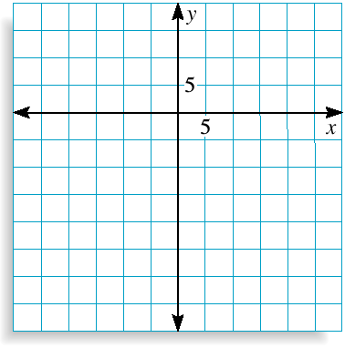
Graphing a Rational Function (m > n)
x ² – 2x – 3
x + 4
Graph y = .
SOLUTION
The numerator can be factored as ( x – 3)
and ( x + 1); the x-intercepts are 3 and –1.
The only zero of the denominator is – 4, so the only vertical asymptote is x = – 4 .
The degree of the numerator (2) is greater than the degree of the denominator (1), so there is no horizontal asymptote and the end behavior of the graph of f is the same as the end behavior of the graph of y = x ^{2 – 1} = x.

Slide 14
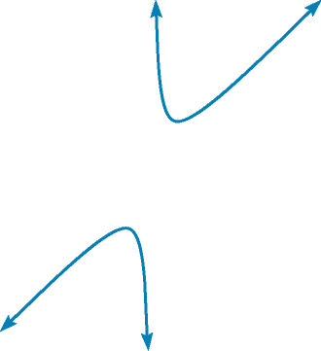
Graphing a Rational Function (m > n)
x ² – 2x – 3
x + 4
Graph y = .
To draw the graph, plot points to the left and right of the vertical asymptote.
x
y
x
y
y
–12
– 9
– 6
– 2
0
2
4
6
– 20.6
–19.2
– 22.5
2.5
– 0.75
– 0.5
0.63
2.1
To the left of
x = – 4
To the right of
x = – 4

Slide 15
Graphing a Rational Function (m > n)
x ² – 2x – 3
x + 4
Graph y = .
Notice anything interesting about this graph?
To draw the graph, plot points to the left and right of the vertical asymptote.
It has what we call a diagonal or “slant” asymptote!
x
y
x
y
y
To find the equation of this line,
use Long Division.
–12
– 9
– 6
– 2
0
2
4
6
– 20.6
–19.2
– 22.5
2.5
– 0.75
– 0.5
0.63
2.1
To the left of
x = – 4
$$x$$
$$−6$$
$$+\frac{21}{x+4}$$
$$x+4$$
$$x^{2}−2x−3$$
- ( )
To the right of
x = – 4
$$x^{2}+4x$$
When we are talking about slant asymptotes, we are talking about “end behavior” as $x→∞$.
$$−6x$$
$$−3$$
- ( )
$$−6x−24$$
For large x values, $y=\frac{x^{2}−2x−3}{x+4}≈x−6$
$$21$$
$y=x−6$ is the slant asymptote

Slide 16
Slant Asymptotes
If the degree of the numerator is exactly one degree more than the denominator, then there is a slant asymptote.
To find it, use Long Division
Extending this idea…
Explore the graph of
$f\left(x\right)=\frac{x^{4}+7x^{2}−9x+1}{5x^{2}−2}$
*see Geogebra
Also explore dividing each term by 5x²

Slide 17
Exploring Discontinuities

