Slide 1
Lesson: _____ Section 6.2 Constructing Antiderivatives Analytically
$$c$$
If F’(x) = 0 on an interval, then F(x) = ____
Two antiderivatives of the same function differ only by a constant.
If F and G are both antiderivatives of f on an interval, then F(x) must equal G(x) + C.
I feel like we need a notation for this process of finding the antiderivative.
$$\int{f\left(x\right)dx=F\left(x\right)+C}$$
This notation for the “general antiderivative” is called the “indefinite integral” (no limits of integration)

Slide 2

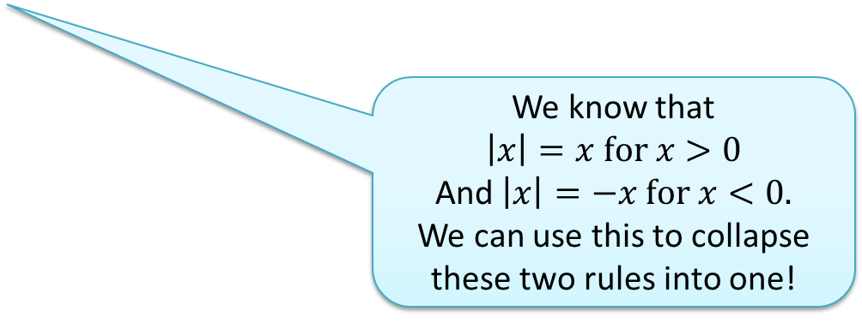
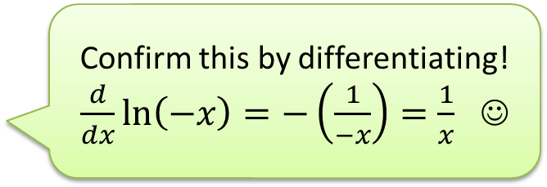
The C makes this the “general” antiderivative instead of just “an” antiderivative
If k is a constant, then
$$\int{kdx= }$$
$$kx+C$$
$$\int{x^{n}dx=}$$
What about the case where n = -1?
What is the antiderivative of $x^{−1} ?$
$\frac{d}{dx}\left(?\right)=\frac{1}{x}$ ?
$$\frac{x^{n+1}}{n+1}+C$$
$$, n≠−1$$
$$\int{\frac{1}{x} dx=}$$
$$ln x+C$$
$$for x>0$$
Confirm this by differentiating!
$\frac{d}{dx}\ln\left(−x\right)=−\left(\frac{1}{−x}\right)=\frac{1}{x}$ ☺
$$\int{\frac{1}{x} dx=}$$
$$ln (−x)+C$$
$$for x<0$$
We know that
$$\left|x\right|=x for x>0$$
And $\left|x\right|=−x for x<0.$
We can use this to collapse these two rules into one!
$$\int{\frac{1}{x} dx=\ln\left|x\right|+C}$$

Slide 3

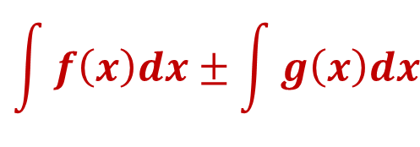

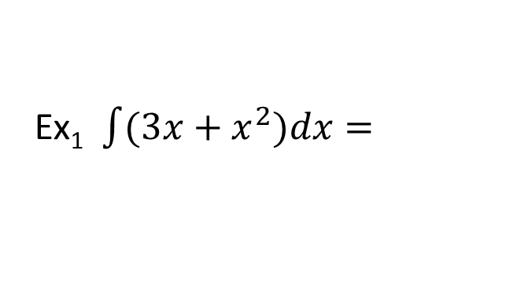
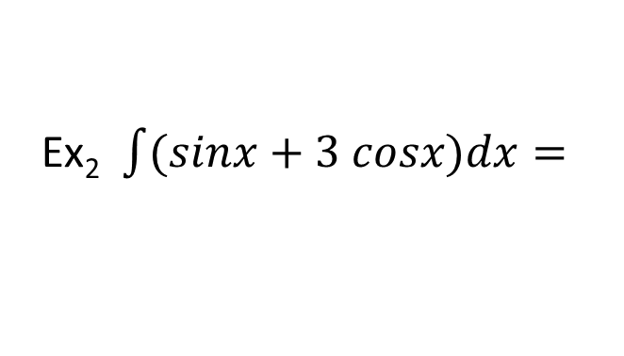
$$\int{e^{x}dx=}$$
$$e^{x}+C$$
$$\int{cosx dx=}$$
$$\int{sinx dx=}$$
$$sin x+C$$
and
$$−cos x+C$$
Ex₁ $\int{(3x+x^{2})dx=}$
We should make a habit of checking our antiderivatives by differentiating
Properties of Antiderivatives
$$\int{[f\left(x\right)±g(x)]dx=}$$
$$\int{cf\left(x\right)dx=}$$
$$\int{f\left(x\right)dx±\int{g\left(x\right)dx}}$$
$$c\int{f\left(x\right)dx}$$
This is fun!(when it works). Sadly, we can’t always do it. Much like evaluating square roots, sometimes we can find antiderivatives easily, sometimes we need a calculator!
Ex₂ $\int{(sinx+3 cosx)dx=}$

Slide 4


Using Antiderivatives to Compute Definite Integrals
with the Fundamental Theorem
$$\int_{1}^{2}{3x^{2}dx=F\left(2\right)−F(1)}$$
An antiderivative could be
$$F\left(x\right)=x^{3}$$
$${=\left(2\right)}^{3}−{ \left(1\right)}^{3}$$
$$=7$$
It’s helpful to have a new notation for this process of plugging the limits into the antiderivative.
What if we used $G\left(x\right)=x^{3}+C$
$$as the antiderivative?$$
$$\int_{1}^{2}{3x^{2}dx=x^{3}\left|{2 \atop 1}\right.={\left(2\right)}^{3}−{\left(1\right)}^{3}}$$
$$\left(x^{3}+C\right)\left|{2 \atop 1}\right.=$$
$$\left(2^{3}+C\right)−\left(1^{3}+C\right)$$
$${=2}^{3}−1^{3}$$
= 7

Slide 5
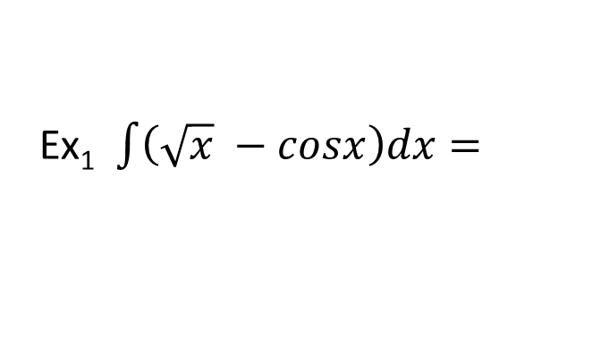
Practice Problems
Ex₁ $\int{\left(\sqrt{x} −cosx\right)dx=}$
Ex₂ $\int{\frac{3}{x^{4}}dx=}$
Ex₃ $\int{\left(5e^{x}+\frac{3}{x}+\sec^{2}{x}\right) dx=}$

Slide 6
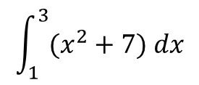
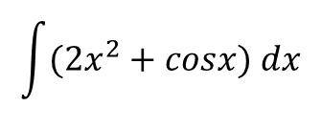
Concepts Quiz !
1.
$$\int{(2x^{2}+cosx) dx}$$
2.
$$\int_{1}^{3}{(x^{2}+7) dx}$$
3.
4.
$$F\left(x\right)=2+\int_{1}^{x}{e^{\sqrt{t}}dt}$$
What does this function represent?
Write an equation to represent the antiderivative of g(x) with an initial value of (2,7)

Slide 8
AP 2014 Q1

