Slide 1
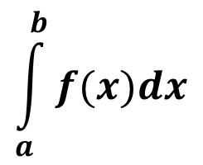
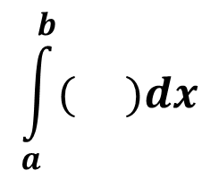
Lesson: ____
Section: 5.3
The Fundamental Theorem & Interpretations
Review of the notation for definite integrals:
$$\int_{a}^{b}{f(x)dx}$$
Is the limit of a sum of terms of the form
f(x) times a small difference in x
$$\int_{a}^{b}{( )dx}$$
The dx is not really a standalone entity, it’s more a part of the symbol meaning “the integral with respect to x.”
We can also think of this dx as an infinitesimally small Δx.
(This helps us to make sense of the units involved.)
e.g. if f(t) is a velocity (in m/s) and dt is an infinitesimally tiny change in time (in seconds), then it makes sense that f(t)dt would yield a distance (in meters).

Slide 2

We’ve seen that the limit of Riemann Sums of the velocity function v = f(t) gives us the net change in position from a to b. We use the notation $\int_{a}^{b}{f\left(t\right)dt}$ to represent this accumulated change in position.
If we let F(t) denote the position function, then the total net change from a to b can be thought of as as well.
F(b) – F(a)
The Fundamental Theorem of Calculus (FTC):
$$If f is continuous on the interval \left[a,b\right]$$
$$and f\left(t\right)=F^{′}\left(t\right), then$$
$$\int_{a}^{b}{f\left(t\right)dt=F\left(b\right)−F(a)}$$
The definite integral of a rate of change gives us the net change in value!
$$F\left(b\right)−F\left(a\right)= Net Change in F\left(t\right) =\int_{a}^{b}{F′\left(t\right)dt}$$
$$between t=a and t=b$$

Slide 3
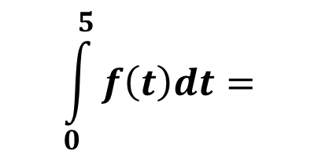
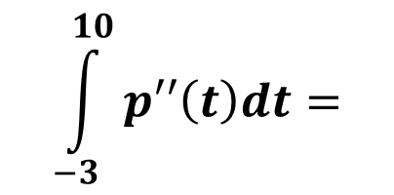
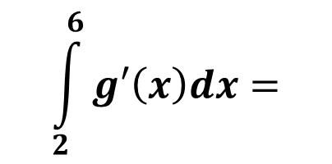
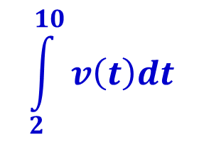
Practicing our fundamentals!
The integral finds the net change in the antiderivative on the interval from 0 to 5.
$$\int_{0}^{5}{f\left(t\right)dt=}$$
$$F\left(5\right)−F(0)$$
$$\int_{2}^{6}{g′\left(x\right)dx=}$$
$$g\left(6\right)−g(2)$$
The definite integral of a rate of change gives us the actual net change in value!
$$\int_{−3}^{10}{p′′\left(t\right)dt=}$$
$$p′\left(10\right)−p^{′}\left(−3\right)$$
$$\int_{2}^{10}{v\left(t\right)dt}$$
$$Given v\left(t\right), use the FTC to represent \\ s\left(10\right)−s\left(2\right) as a definite integral.$$

Slide 4
Open your text to page 257
See p.257 ex. 2 - Note that integrating the rate function yields the change in the number of bacteria, not the actual number of bacteria present. To find that you’d need the change AND an initial value.
See ex. 3
See ex. 4 Think about each question before discussing the solutions together

Slide 5
How do we find the average value of a continuously changing function?
We could take a bunch of measurements, then add
them all up and divide! For example, let’s think about
the average temperature in a day.
?
The average temp would be
$≈\frac{f\left(t_{1}\right)+f\left(t_{2}\right)+…+f(t_{n})}{n}$
The larger we make n, the better the approximation. Since $0≤t≤24, then ∆t=\frac{24}{n}. As a result, we could say that n=\frac{24}{∆t}.$
Average temp $≈\frac{f\left(t_{1}\right)+f\left(t_{2}\right)+…+f(t_{n})}{{24}/{∆t}}$
$$≈\frac{1}{24}∗\sum_{i=1}^{n}{f(t_{i)}∆t}$$
$≈\frac{f\left(t_{1}\right)∆t+f\left(t_{2}\right)∆t+…+f(t_{n})∆t}{24}$
$$If we take the limit as n→∞, then$$
$$Average Temp≈\frac{1}{24}∗\int_{0}^{24}{f\left(t\right)dt}$$

Slide 6

In general...
$$=\frac{1}{b−a} \int_{a}^{b}{f\left(x\right)dx}$$
The Average value of f
from a to b
To visualize this, we can see that it then follows that
$\left(Average value of f\right)∗\left(b−a\right)=\int_{a}^{b}{f\left(x\right)dx}$
The area of this rectangle = The area under the curve
Avg. value of f
a
b
b – a

