Slide 1
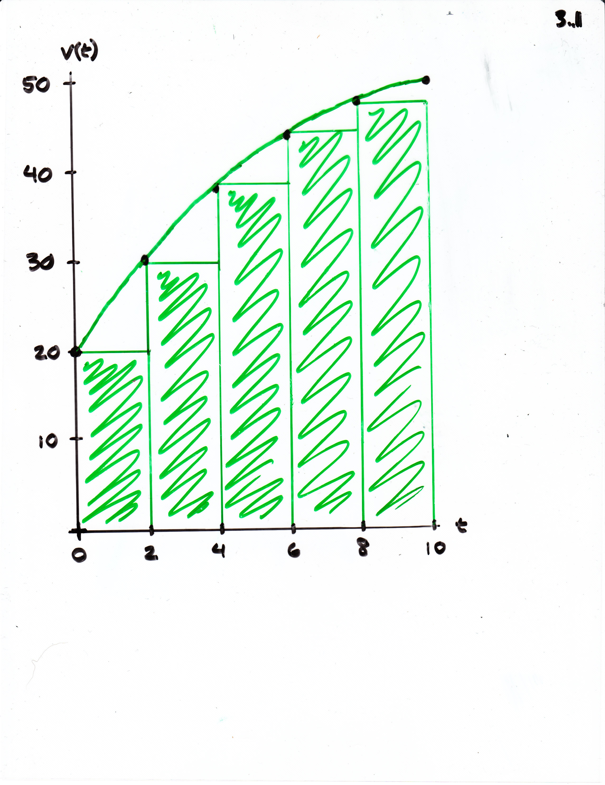
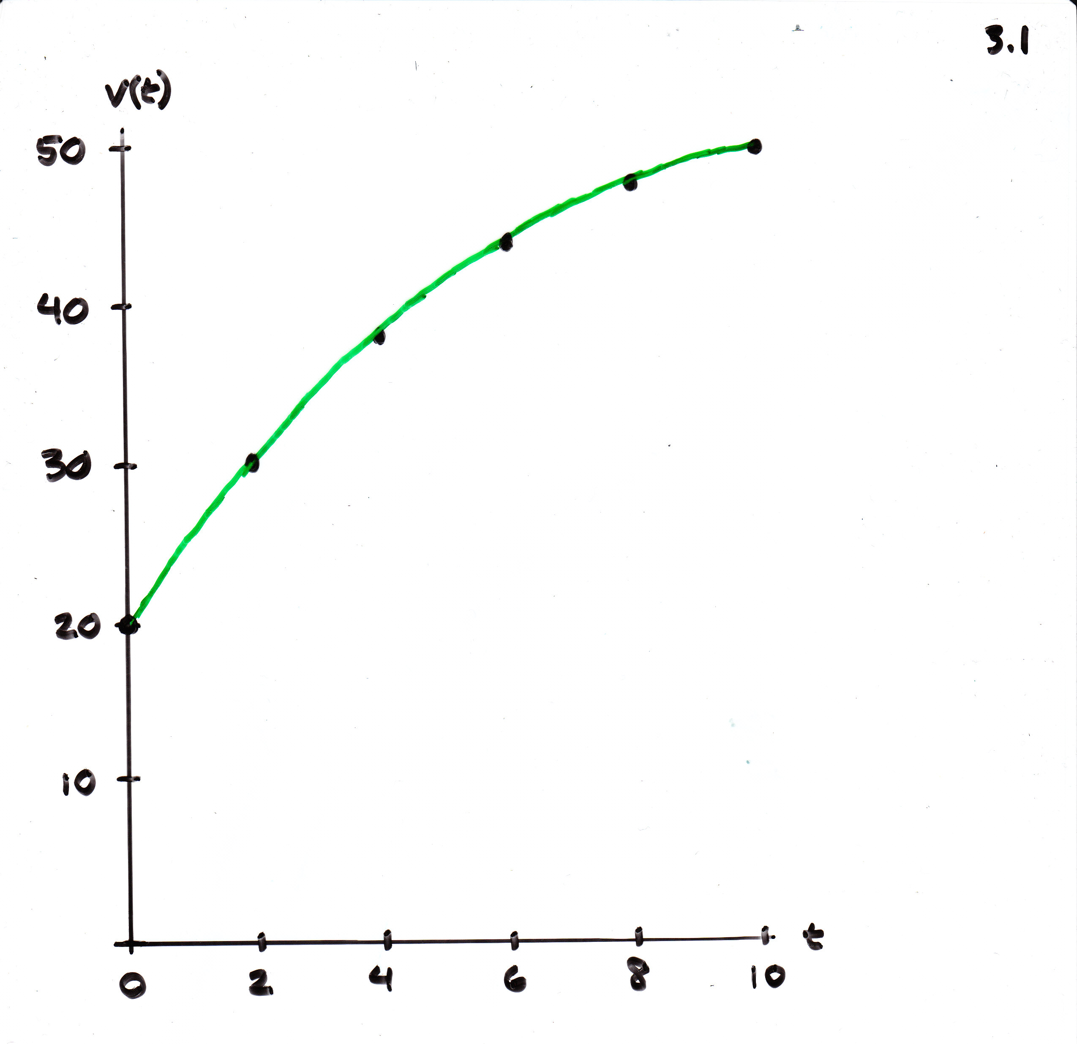
Underestimate of the distance traveled/area under the curve

Slide 2
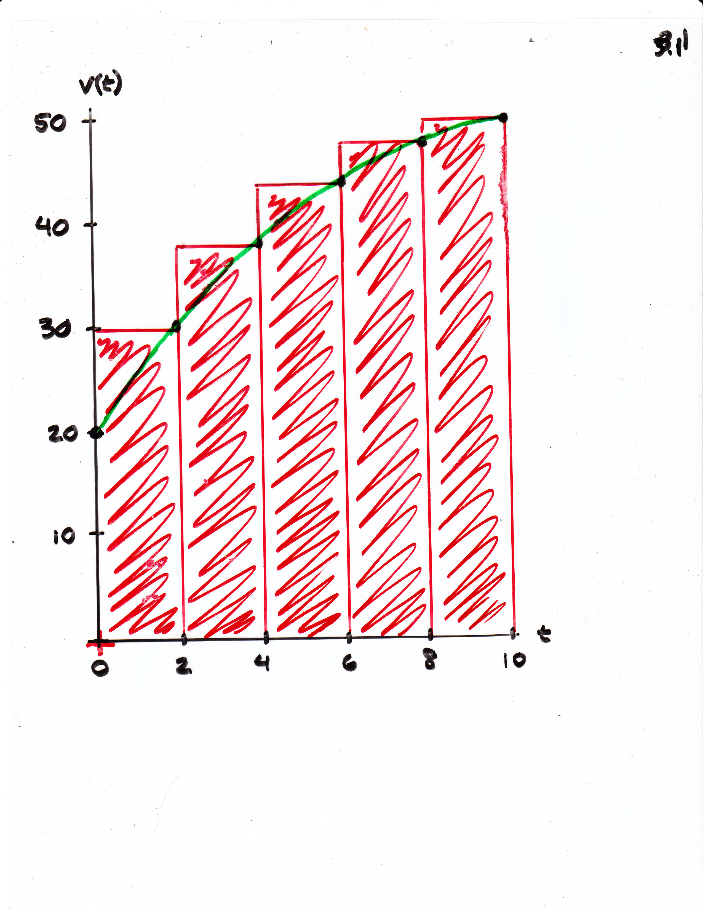
Overestimate of the distance traveled/area under the curve

