Slide 1

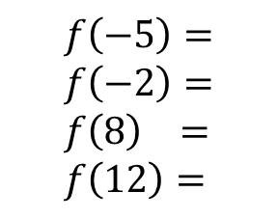
Lesson: ____
Section: 4.3
Optimization
Click here
51 sec mark
What is optimization?
The process of finding the best!
(usually the max or min)
All global extrema occur at either critical points or endpoints of the interval.
So our task is to find all these candidates and compare their values!
Find the global (or absolute) max/min over the closed interval from $−5≤x≤12$
$$f\left(x\right)=x^{3}−9x^{2}−48x+52$$
$$f^{′}(x)=3x^{2}−18x−48$$
$$f\left(−5\right)= \\ f\left(−2\right)= \\ f\left(8\right) = \\ f\left(12\right)=$$
$$−58 \\ 104 \\ −396 \\ −92$$
$$=0$$
$$3\left(x+2\right)\left(x−8\right)=0$$
Global Max
Critical Points
$$x=−2, x=8$$
Global Min
Test my candidates (Critical & End points)
These are also called the upper and lower “bounds” of the function.
$$−396≤x^{3}−9x^{2}−48x+12≤104$$

Slide 2


Find the global (or absolute) max/min over the open interval from $−5≤x<∞$
There is no right “endpoint”, so we need to explore the end behavior of the function as $x→∞$
$$f\left(x\right)=x^{3}−9x^{2}−48x+12$$
$$f^{′}(x)=3x^{2}−18x−48$$
$$=0$$
$$3\left(x+2\right)\left(x−8\right)=0$$
$$x=−2, x=8$$
To find the global max/min of a continuous function over an OPEN interval or on all real numbers:
Find the value of the function at all critical points.
Look at the function values when x approaches the endpoints of the interval (remember that we never reach these points)
Look at the behavior as $x→±∞$ as appropriate.
Test my candidates (Crit & End points)
$$f\left(−5\right)= \\ f\left(−2\right)= \\ f\left(8\right) =$$
$$−58 \\ 104 \\ −396$$
$As x→∞,$
$$f\left(x\right)→∞$$
Since the lead coeff is positive, this function is rising to the right without bound,
so there is no global maximum.
The global minimum is still at (8, -396)
$$−396≤x^{3}−9x^{2}−48x+12$$
Lower bound is -396
No upper bound

Slide 3
The existence of Global Extrema over a closed interval is guaranteed by the…
EXTREME VALUE THEOREM (E.V.T.) If f is continuous on the closed interval from [a,b], then f must have a global maximum and a global minimum on that interval.
Note: This is not necessarily true if the interval is open, but if the interval is closed, then both a maximum and minimum value must exist!

Slide 4
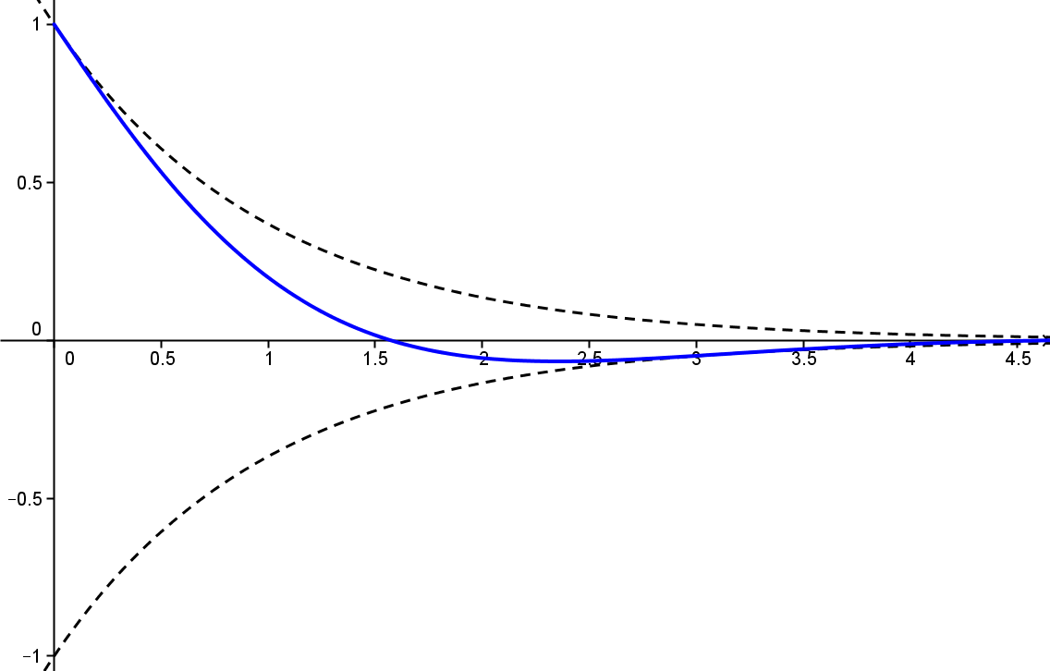
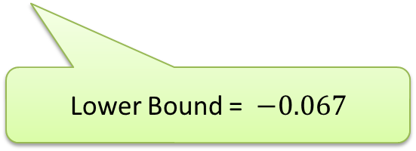
Explore damping factors in general on Geogebra if time allows!
Ex. 4
Find the upper and lower bounds for $y=e^{−t}\cos\left(t\right), for t≥0$
Upper bound = 1
$$y=e^{−t}cos⁡(t)$$
$$y^{′}={−e}^{−t}\cos\left(t\right)+e^{−t}(−\sin\left(t\right))$$
${−e}^{−t}(\cos\left(t\right)+\sin\left(t\right))$
$$=0$$
$\cos{t+\sin{t=0}}$
$\sin{t=−\cos{t}}$
Lower Bound = $−0.067$
$\frac{\sin{t}}{\cos{t}}=\frac{−\cos{t}}{\cos{t}}$
Lower Bound? .
Find it!
$\tan{t=−1}$
$$−0.067≤e^{−t}cos⁡(t)≤1$$
$t=\frac{3π}{4}≈2.356$
$y=e^{\frac{−3π}{4}}\cos\left( \right)$
$$\frac{3π}{4}$$
$$≈−0.067$$

Slide 5
Review of Concepts
(pop quiz for day after)
How do we find the “critical points” of a function?
How do we determine whether a critical point is a max, a min, or neither? (2 ways)
How do we find inflection points?
What does it mean to “optimize” a quantity?
How do we use calculus to do this?
What does the E.V.T. claim? Be careful to note the hypotheses that must be satisfied in order to draw this conclusion.
The E.V.T. does not apply to open intervals. How do we find the global extrema if an interval has an open endpoint or is unbounded?

Slide 6
Review of Concepts
(pop quiz for day after)
How do we find the “critical points” of a function? Find where the derivative is zero or undefined.
How do we determine whether a critical point is a max, a min, or neither? (2 ways) First Deriv. Test for Local Extrema
(set up test intervals for the deriv and look for sign changes)
Second Deriv Test
(plug critical points into the second deriv. If +, then CU, therefore a minim.)
How do we find inflection points? Find when second derivative is zero or undef. Then set up test intervals and look for a sign change.
What does it mean to “optimize” a quantity? To find the best value. Usually a global max or min.
How do we use calculus to do this? We look at the behavior at critical and endpoints. These are called “candidates.”

Slide 7
Review of Concepts
(pop quiz for day after)
What does the E.V.T. claim? Be careful to note the hypotheses that must be satisfied in order to draw this conclusion. IF a function is continuous over a closed interval…
THEN a global min and a global max must exist within that interval.
The Extreme Value Theorem guarantees the existence of Extreme Values!
(on a closed interval)
The E.V.T. does not apply to open intervals. How do we find the global extrema if an interval has an open endpoint or is unbounded?
We explore behavior at critical points and included endpoints as before and also consider the end behavior as we approach the open endpoint or infinity as appropriate.

Slide 8
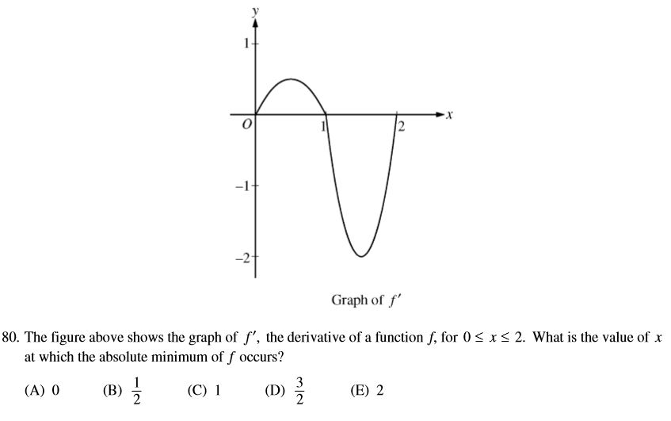
E
ANSWER

