Slide 1
Lesson: ____
Section: 2.6
Differentiability
A function is differentiable at a point if it has a derivative there. In other words…

Slide 2
A function fails to be differentiable at point $x$ if:
The function is discontinuous at $x$
The graph has a sharp corner at $x$
The graph has a vertical tangent line at $x$

Slide 3
The relationship between differentiability and continuity
If a function is differentiable at $x=a$, then it must be continuous at $x=a$.
$$differentiable→continuous$$
Does this imply the converse? If not, give a counterexample?

Slide 4
To prove that a function is continuous, show that
$\lim_{x→c}{f\left(x\right)=f(c)}$
This is called the “definition of continuity”
To prove that a function is differentiable, show that the limit of the diff. quotient as h→0 exists.
$\lim_{h→0}{\frac{f\left(x+h\right)−f(x)}{h}}$
This is called the “definition of the derivative”

Slide 5
Just for fun, let’s try finding the derivative using the “power rule”
$$\lim_{h→0 }{\frac{f(0+h)−f(0)}{h}}$$
$$f\left(x\right)=x^{\frac{1}{3}}$$
$$\lim_{h→0 }{\frac{{\left(0+h\right)}^{\frac{1}{3}}−{\left(0\right)}^{\frac{1}{3}}}{h}}$$
$$f′\left(x\right)={\frac{1}{3}x}^{\frac{−2}{ 3}}$$
$$f′\left(x\right)=\frac{1}{3x^{\frac{2}{3}}}$$
$$\lim_{h→0 }{\frac{{\left(h\right)}^{\frac{1}{3}}}{h}}$$
$$f′\left(x\right)=\frac{1}{3\sqrt[3]{x^{2}}}$$
$$\lim_{h→0 }{\frac{1}{h^{\frac{2}{3}}}}$$
$$=\frac{1}{0}$$
$$f′\left(0\right)=\frac{1}{3\sqrt[3]{0^{2}}}$$
$$=undefined$$
$$=\frac{1}{0}$$
Since the limit does not exist at 0, the function is not differentiable at x=0
Now confirm by “going visual”

Slide 6
Is g(x) continuous at 1? Is it differentiable at 1?

Slide 7
$$p→q$$
Review of Proofs in Calculus (Prove, Show, Demonstrate, Justify…)
Ex. Show that $f(x)=x^{2}$is continuous at $x=5$.
We can see that $\lim_{x→5^{−}}{f\left(x\right)=}\lim_{x→5^{+}}{f\left(x\right)=25}$
Therefore$\lim_{x→5}{f\left(x\right)=f(5)}.$
Hence the function is continuous at $x=5$by the definition of continuity ☺
and $f\left(5\right)=5^{2}=25$
Ex. Show that $f\left(x\right)=x^{2}$is differentiable at $x=5$.
$$\lim_{h→0 }{\frac{f(5+h)−f(5)}{h}=}$$
$$\lim_{h→0 }{\frac{ (5+{h)}^{2}−5^{2}}{h}=}$$
$$\lim_{h→0 }{\frac{ 25+10h+h^{2}−25}{h}=}$$
Hence the function is differentiable at $x=5$by the definition of the derivative ☺
$$=\lim_{h→0 }{\frac{ h(10+h)}{h}=}$$
$$\lim_{h→0 }{(10+h)=}$$
$$10$$

Slide 8
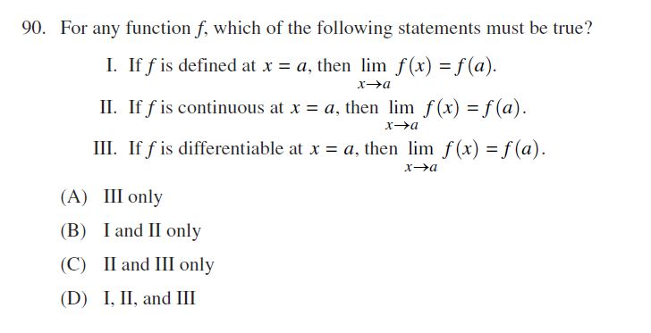
C
ANSWER

