Slide 1
Lesson: ____
Section: 2.5
The Second Derivative
The derivative is itself a function. This function also has a rate of change, so we can therefore consider its derivative as well. The derivative of the derivative is called the “second derivative.”
$f′′(x)$ or $\frac{d^{2}y}{dx^{2}}$ or $\frac{d^{2}}{dx^{2}}(y)$
What do derivatives tell us?
The derivative of a function tells us how a function is increasing or decreasing. It expresses the rate of change.
The second derivative tells us how this rate of change is increasing or decreasing.

Slide 2
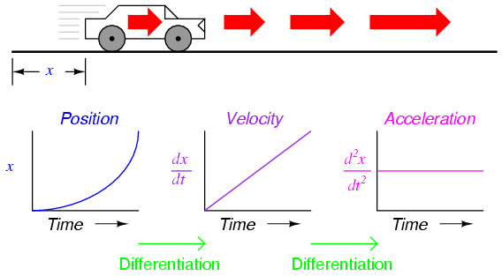
s(t)
s’(t)
s’’(t)
Differentiation Differentiation

Slide 3
What does the derivative tell us about the original function?
f | f’ | f’’
 | Positive | x
 | Negative | x
 | Zero (with sign change) | x
 |  | Positive
 |  | Negative
 |  | Zero (with sign change)
Incr.
Decr.
Max/Min
Concave Up
Concave Down
Inflection Pt.
Incr.
Decr.
Max/Min
Check out Geogebra Graphs

Slide 4
What does the original function tell us about its derivatives?
f | f’ | f’’
Incr. |  | x
Decr. |  | x
Max/Min |  | x
Concave Up
Concave Down
Inflection Pt.
≥ 0
≤ 0
Zero (with sign change)
Consider the derivative of f(x) = x⁴
Incr.
Decr.
Max/Min
≥ 0
≤ 0
Zero (with sign change)
← Sketch a basic cubic on the side for reference
Notes:
Don’t belabor this! Just beware the converse error in general and pay attention to boundaries (include or not include)

Slide 5
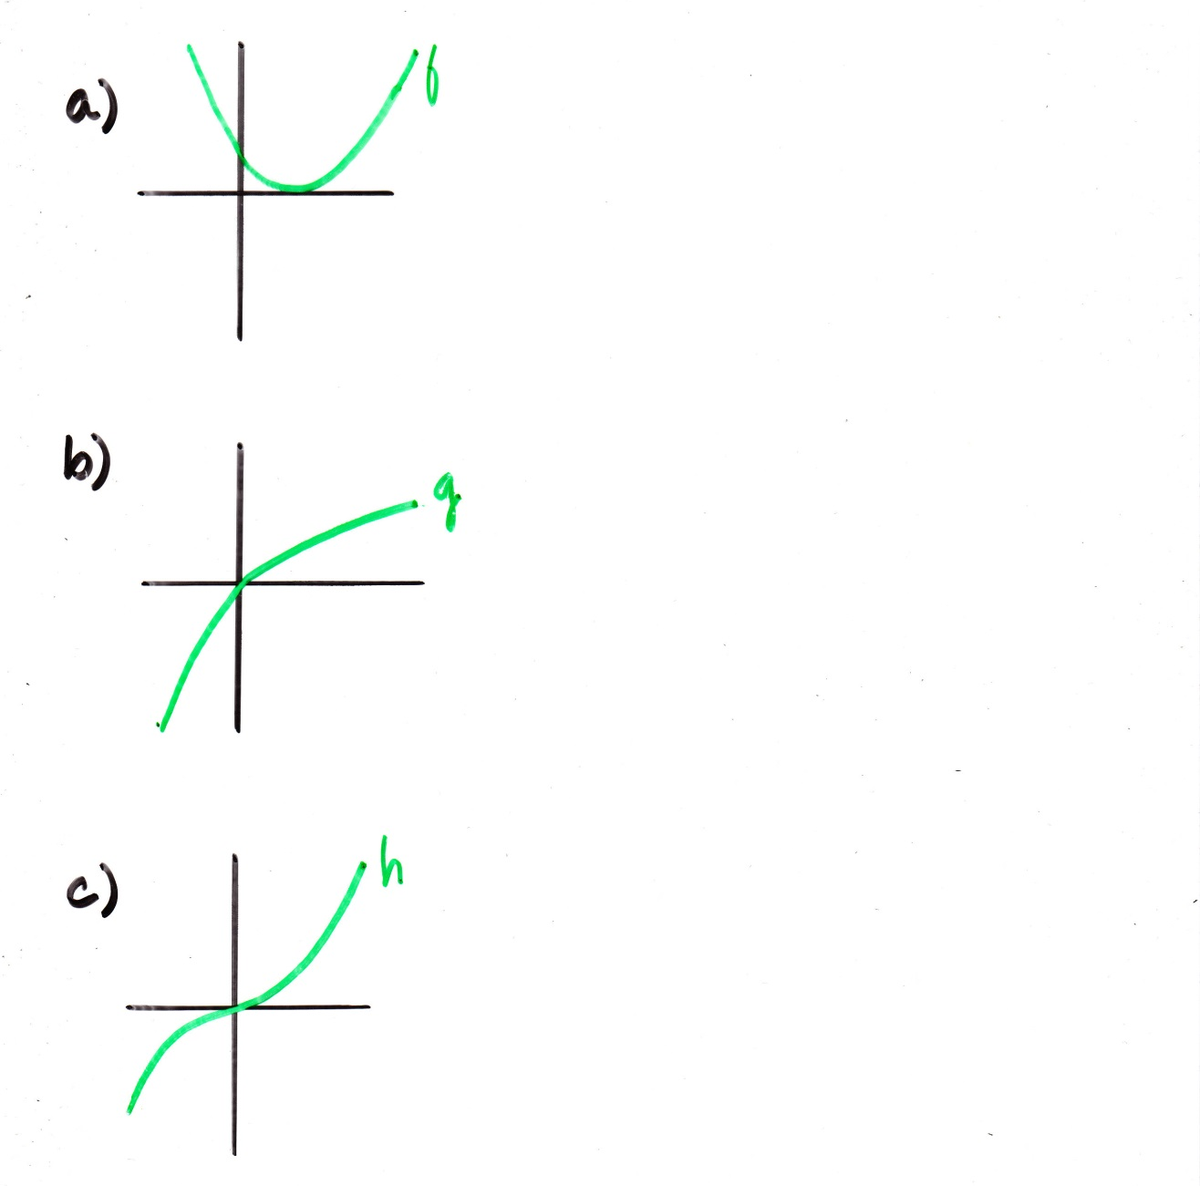
Ex₁) Determine where the second derivative is positive; negative.
$$The graph is concave up everywhere, \\ so f^{′′}≥0 everywhere.$$
$$The graph is concave down everywhere, \\ so f^{′′}≤0 everywhere.$$
Incr. Incr.
f(x)
CD CU
+ +
f'(x)
Decr Incr.
– +
f‘’(x)

Slide 6
Determine the polarity of f, f’, and f’’ at the given points
$$f$$ | $$f’$$ | $$f’’$$

Slide 7
Ex.3 A population, P, growing in a confined environment often follows a logistic growth curve (below). Use d²P/dt² to describe how the rate at which the population is increasing changes over time. What are the practical interpretations of t₀ and L?
For $t<t_{0}$ we can see that $\frac{d^{2}P}{dt^{2}}$
$$>0$$
The population is increasing at an increasing rate!
For $t>t_{0}$ we can see that $\frac{d^{2}P}{dt^{2}}$
$$<0$$
The rate at which the population is increasing is decreasing over time.

Slide 8
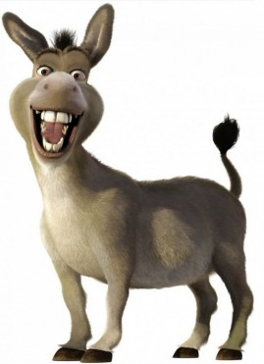
4
Interval | 0-3 | 3-6 | 6-9 | 9-12
Approx. avg rate of change (dv/dt) | 6.67 | 4.33 | 3.33 | 2.67
Go visual!
*Note that the velocity increases by 20, then 13, then 10, then 8.
So velocity is increasing , but the rate is decreasing as time goes on
This means v(t) is increasing but concave down. Therefore v’’(t) is negative!

Slide 9
Ex.5 A particle is moving along a straight line. Its distance, s , to the right of a fixed point is shown below.
s
What’s happening here?
What’s happening here?

Slide 10
Acceleration is the rate of change of velocity with respect to time.
If velocity is given as $v\left(t\right),$ then
Instantaneous acceleration = $v′(t)$
What do derivatives tell us?
If $y=s\left(t\right)$is the position of an object at time t, then
$$a\left(t\right)=v^{′}\left(t\right)=s^{′′}\left(t\right)$$
$$v\left(t\right)=\frac{dy}{dt}$$
$$a\left(t\right)=\frac{d^{2}y}{dt^{2}}$$

Slide 12
Notes:
Freeze and use pen to label f(x) f’(x) f’’(x) on stairs as a joke

Slide 13
