Slide 1
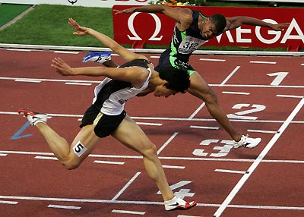
Lesson: ____
Section: 2.1
Key Concept:
The Derivative
Essential Question: “How do we measure speed?”
s(b) -
s(a) -
a
b
Compare the blue runner to the red and green runners.
How fast is the blue runner traveling?

Slide 2
Essential Question: “How do we measure speed?”
s(b) -
s(a) -
a
b
Note: final - initial
Average velocity over the interval $[a,b]$
$$=\frac{∆s }{∆t}$$
$$=\frac{s\left(b\right)−s(a)}{b−a}$$
x | 3 | 4 | 5 | 6 | 7 | 8
f(x) | 1.1 | 1.7 | 2.2 | 2.7 | 3.1 | 3.2
Find the average velocity on the interval [4, 7] and visualize this on a graph.
On [4,6]?
On [4,5]?
At $t=4$ ???
If I had a formula for this function, how could I use this idea of the average rate of change over an interval to get a really precise estimate for the instantaneous rate at 4?

Slide 3
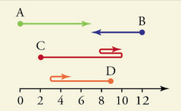
A little bit o’physics vocab…
How are speed and velocity related?
velocity is a directed speed
Speed = $\left|velocity\right|$
position is a directed distance
distance = $\left|position\right|$
The change in position $(∆s)$ is called “displacement”
$$Change in distance = \left|displacement\right|$$
Velocity, position, and displacement are considered vector quantities in that they have both direction and magnitude
*Note: total distance traveled is not the same as the magnitude of displacement
Ex. The magnitude of the displacement for point C is 8, but the total distance traveled by C is 12

Slide 4
Lesson: ____
Section: 2.1-3
Key Concept:
The Derivative
Notes:
First time through, do this on the side board, then use this slide as a review for the future

Slide 5
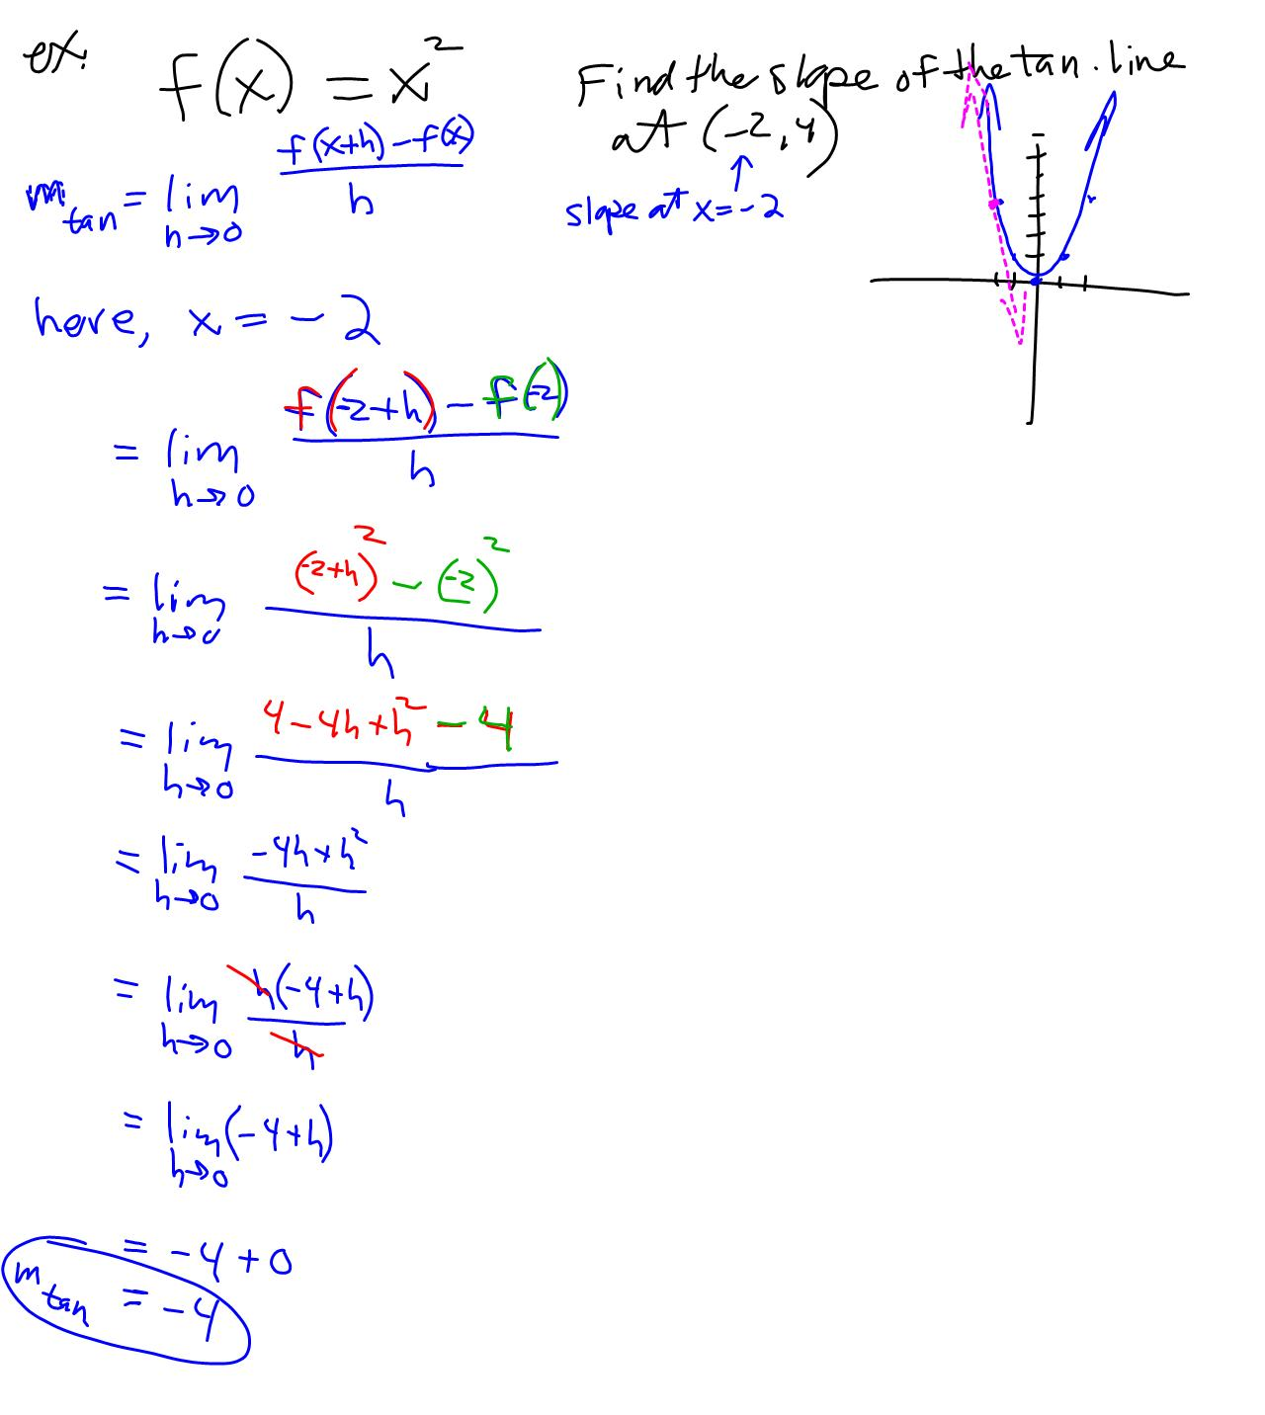

Slide 7
Lesson: _______ Section 2.3 - The Derivative Function
Warmup:
The derivative of $f$ at $x=3$
The SLOPE of the curve at 3
The SLOPE of the tangent line at 3
The instantaneous RATE OF CHANGE at 3
$1. What does f^{′}\left(3\right) mean?$ Give 4 different answers!
$$2. \lim_{h→0}{\frac{g\left(5+h\right)−g(5)}{h}= ?}$$
$$g′(5)$$
This is called the definition of the derivative!
$$f^{′}\left(x\right)=\lim_{h→0}{\frac{f\left(x+h\right)−f(x)}{h}}$$
If we can find a derivative at x, then we say that the function is “differentiable” at x.
Most functions are differentiable at every point in their domain except perhaps for a few isolated values.

Slide 8
Estimating the Derivative from a Graph
max
INCR
DECR
f(x)
The polarity of the derivative tells us the behavior of the original function!
2
+
–
f'(x)
2
f’(x) = 0
The behavior of the derivative tells us the concavity of the original function!
Q: Where is$f’(x)$increasing or decreasing?
A: $f’(x)$is everywhere decreasing (concave down means decreasing slope)

Slide 9
Relationships between a function & its derivatives
f | f’ | f’’
Incr. |  | x
Decr. |  | x
Max/Min |  | x
Concave Up
Concave Down
Inflection Pt.
← Sketch a basic cubic on the side for reference

Slide 10
Relationships between a function & its derivatives
f | f’ | f’’
Incr. |  | x
Decr. |  | x
Max/Min |  | x
Concave Up
Concave Down
Inflection Pt.
Positive
Negative
Zero (with sign change)
Increasing
Decreasing
Max/Min
Positive
Negative
Zero (with sign change)
← Sketch a basic cubic on the side for reference

Slide 11
Based on the information in the number line for a continuous function f(x), describe it’s derivative over each interval & at the points where x = 2 and x = 9.
f(x) has an inflection point
f(x) has a maximum
INCR DECR DECR
f(x)
CD CD CU
2 9
+ – –
f’(x)
2 9
DECR DECR INCR
f’(x) = 0
f’(x) has a minimum

Slide 12
Original Functions
Match the function with its derivative
Derivative Functions
More sketching examples (from worksheets) and concept quizzes at end of PPt.

Slide 13
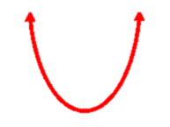
Estimate and sketch the Graph of the Derivative
Remember! The derivative at x is the slope at x
f(x)
f’(x)
At x = 3, f’(x) ≈ -5/2
At x = 8, f’(x) ≈ 5/2
At x = 5.5, f’(x) = 0

Slide 14
Numerical Estimation of the Derivative
How?
Ex. Use the information in the table to estimate the value of $f’(4)$
x | 3 | 4 | 5 | 6 | 7 | 8
f(x) | 1.1 | 1.7 | 2.2 | 2.7 | 3.1 | 3.2
Slope to the left of 4 $≈0.6$
Slope to the right of 4 $≈0.5$
Our best estimate for the slope at 4 is the average of these two slopes $≈0.55$
$$f’(4)≈0.55$$
Ex. Given that $f\left(x\right)=\sqrt{x}$
Use your calculator’s TABLE feature to estimate $f’(4)$ by averaging the slope over small intervals to the left and right of 4.
* Now go to the graph and choose CALC $→$ $dy/dx$ at $x=4$
How close were we? How could we improve the estimate?
Note: Check out DRAW $→$ TANGENT also!

Slide 15
Finding the Derivative from a Formula
$$f\left(x\right)=k f’\left(x\right)=$$
$$0$$
$$m$$
$$g\left(x\right)=b+mx g’\left(x\right)=$$
$$2x$$
$$h\left(x\right)=x^{2} h’\left(x\right)=$$
$$3x^{2}$$
Ex.5 on p.85 shows the steps
$$i\left(x\right)=x^{3} i’\left(x\right)=$$
$$4x^{3}$$
$$j\left(x\right)=x^{4} j’\left(x\right)=$$
Remember… $x^{n}$ is called a “power”
☺ The Power Rule
$$If f\left(x\right)=x^{n} then \\ { f}^{′}\left(x\right)=$$
$${n x}^{n−1}$$

Slide 16
What do you notice about the y-values of the derivative where the function reaches a point of inflection?

Slide 17
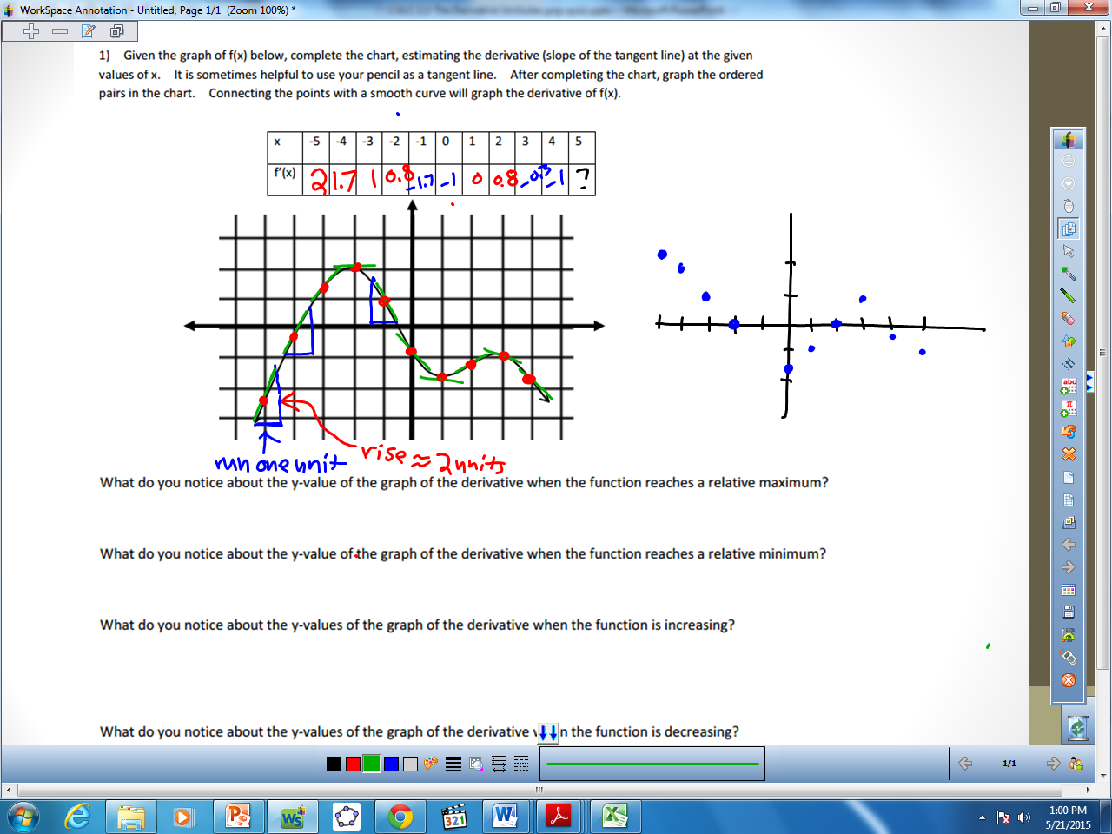
What do you notice about the y-values of the derivative where the function reaches a point of inflection?

Slide 19
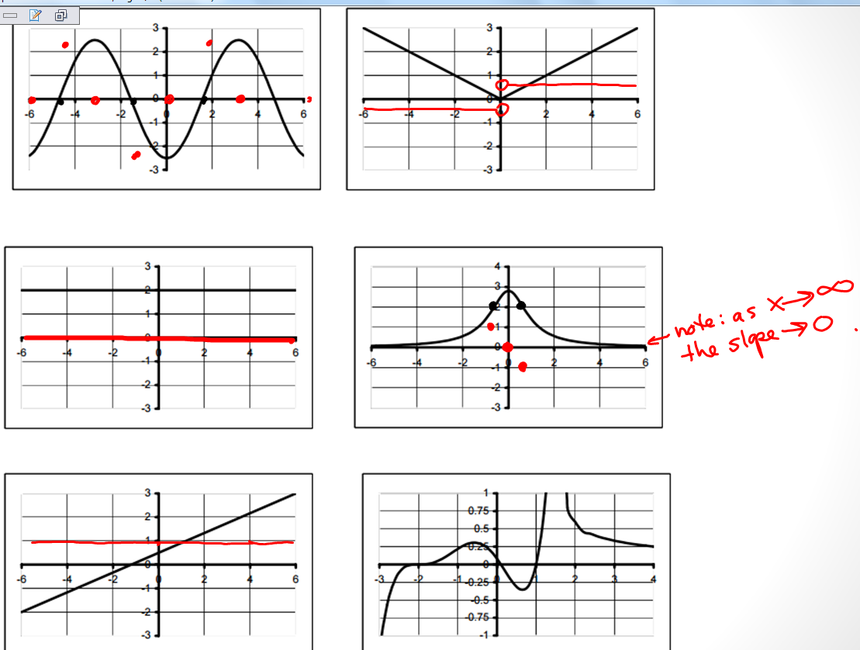
See next slide

Slide 20
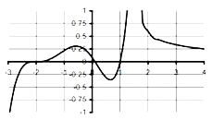
As $x→{1.5}^{−}$
slope $→∞$
As $x→{1.5}^{+}$
slope $→−∞$
As $x→∞$
slope $→0$
As $x→−∞$
slope $→∞$ (larger and larger positive slopes)
We analyzed the slope at key points such as extrema, inflection points, and discontinuities.
We also analyzed the end behavior.
Lastly, let’s analyze slope on specific intervals and see if our graph checks out.

Slide 21
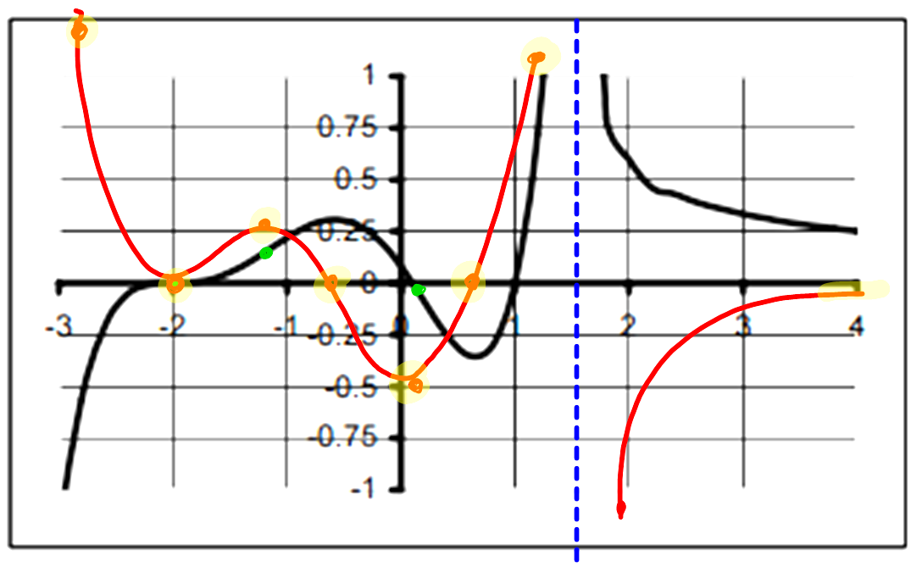

Slide 22
Relationships between a function & its derivative
If f(x) is decreasing over an interval, then f’(x) is __________________
If f(x) is increasing over an interval, then f’(x) is __________________
If f(x) is concave up over an interval, then f’(x) is _________________
If f(x) is concave down over an interval, then f’(x) is _______________
If f(x) has an extremum at x = c, then f’(c) ___________
If f(x) has an inflection point at x = k, then f’(x) ______________
If then ________
If g’(x) > 0, then g(x) _____________
If g’(x) is increasing, then g(x) _____________
If g’(x) = 0, then g(x) _____________________
Sketch a graph for h(x) that meets the following criteria:
h’(x) is increasing from (-∞, 3) and decreasing from (3,∞)
What if the same rule from ex.11 applies, but h’(x) must also be ≥0?

Slide 23
(Sketch with Interwrite)
Relationships between a function & its derivative
If f(x) is decreasing over an interval, then f’(x) is __________________
If f(x) is increasing over an interval, then f’(x) is __________________
If f(x) is concave up over an interval, then f’(x) is _________________
If f(x) is concave down over an interval, then f’(x) is _______________
If f(x) has an extremum at x = c, then f’(c) ___________
If f(x) has an inflection point at x = k, then f’(x) ______________
If then ________
Negative
Positive
Increasing
11.
12.
Decreasing
= 0
Is at a max or min
0
If g’(x) > 0, then g(x) _____________
If g’(x) is increasing, then g(x) _____________
If g’(x) = 0, then g(x)
Sketch a graph for h(x) that meets the following criteria:
h’(x) is increasing from (-∞, 3) and decreasing from (3,∞)
What if the same rule from ex.11 applies, but h’(x) must also be ≥0?
Is increasing
Is Concave Up
Is a horizontal line.
If g’(c) = 0, then g(c) may be an extremum (if accompanied by a sign change)

Slide 24
Sketch a continuous curve which satisfies the following
When x < -2, f(x) is negative and increasing and f’(x) is increasing.
When –2 < x < 3, f(x) is increasing and f’(x) is decreasing
When 3 < x < 6, f’(x) = 0
When x > 6, f’(x) is negative and decreasing
-2 3 6
True or False?
If I have the graph of a function, I can usually graph the derivative.
If I have the graphs of the derivative, I can usually graph the original function.
What does the derivative tell me about the original graph? What else would I need in order to graph the original function?
Ex. show graph of f'(x) as a line
Let’s play with the notation a bit:
If the number of chicken wings I eat is a function of time in hours, what does f(2) = 50 mean? What does f '(2) = 10 mean?

Slide 25
Sketch a continuous curve which satisfies the following
When x < -2, f(x) is negative and increasing and f’(x) is increasing.
When –2 < x < 3, f(x) is increasing and f’(x) is decreasing
When 3 < x < 6, f’(x) = 0
When x > 6, f’(x) is negative and decreasing
Let’s focus on function f here.
→ f is concave up
→ f is concave down
→ f is constant (horizontal line)
→ f decreasing and concave down
-2 3 6

