Slide 1
Differential Equations & Slope Fields
Lesson: ____
Section: 11.1-3
A “differential equation” is an equation involving the derivative.
It tells us information about the rate of change of some unknown function.
Any function y that satisfies the diff. eq. is called a solution.
A “first order” diff. eq.
A “first order” diff. eq.
A “second order” diff. eq.
Ex. $\frac{dy}{dx}=2x$ Ex. $y^{′}=\frac{1}{x}$ Ex. $\frac{d^{2}y}{dx^{2}}=−9.8$
$$y=x^{2}+C$$
$$\frac{dy}{dx}=−9.8x+C$$
S$olutions:$
$y=ln\left|x\right|+C$
$$y=−4.9x^{2}+C_{1}x+C_{2}$$
These general equations are called “families of solutions”
To find a specific solution, we’d need an initial value(s).

Slide 2
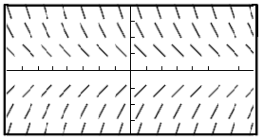
A “slope field” is a way of visualizing a differential equation.
These little tiny tangent lines help us to visualize the slope at each point. Think of them as compass needles or signposts telling us which way to go if we happen to be standing at that point.
Let’s say, we choose an initial value of (-3,3). What would the solution look like?
What if we had (1,-3) as an initial value?

Slide 3
Construct a slope field for the given differential equation
Ex. $\frac{dy}{dx}=2x$
Point | Slope
(0,0) | 0
(0,1) | 0
(0,2) | 0
(1,0) | 2
(1,1) | 2
(1,2) | 2
(2,0) | 4
(2,1) | 4
(-1,0) | -2
(-1,-2) | -2
(-2,0) | -4
What does the slope field suggest about the family of solutions to the given differential equation?
Sketch in a few particular solutions.
We know analytically that the solution is $y=x^{2}+C$ which clearly matches up with our slope field

Slide 4
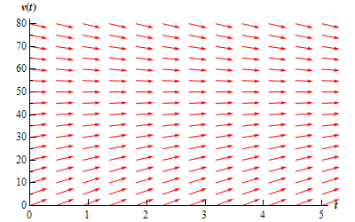
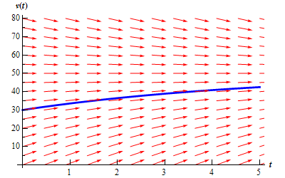
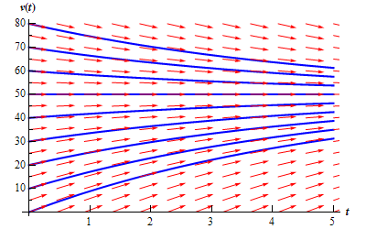
Given the slope field for
some differential equation
With an initial value of $y\left(0\right)=30,$
the solution would look like this:
The general “family of solution curves” would look something like this:

Slide 5
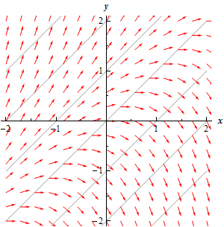
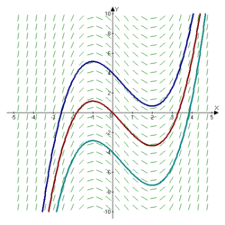
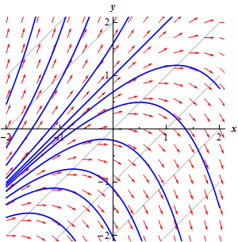
More examples:
$$y^{′}=y−x$$
$$\frac{dy}{dx}=x^{2}−x−2$$
Note that changing y has no effect on the slope. This is true since the diff. eq. is defined only in terms of x. How would it change if it were only in terms of y?
What if it were defined in terms of both x and y?

Slide 6
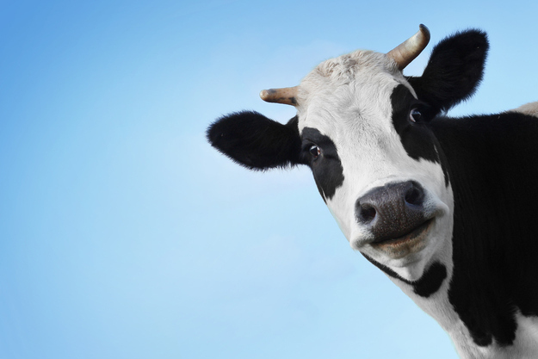
Complete problems 2a, 4, 8 on the class handout.
Then do Free Response Question 5a. We’ll do 5b later on.

Slide 7
Solving Differential Equations by Separation of Variables
Solve the differential equation.
$$\frac{dy}{dx}=−\frac{x}{y}$$
We are going to obtain this solution using a method called “separation of variables.”
$$ydy=−xdx$$
Basically, we are going to get all the x’s on one side, and all the y’s on the other and then integrate each side separately
$$\int{ydy}=−\int{xdx}$$
$$\frac{y^{2}}{2}=−\frac{x^{2}}{2}+C$$
$$\frac{y^{2}}{2}+\frac{x^{2}}{2}=C$$
$$y^{2}+x^{2}=2C$$
So the family of solution curves is the set of circles with centers at the origin.
$$y^{2}+x^{2}=k$$

Slide 8
Free Response Question 5b
5b. Find the particular solution to the differential equation with the initial
condition$f\left(−1\right)=1$and state it’s domain.
$$\frac{dy}{dx}=\frac{1+y}{x} , x≠0$$
$$\frac{1}{1+y}dy=\frac{1}{x}dx$$
separate the variables
$$\int{\frac{1}{1+y}dy}=\int{\frac{1}{x}dx}$$
the rule no longer applies at x = 0
integrate
both sides
Domain:
$$x<0$$
The domain of a particular solution to a diff. eq. is defined as the largest open interval containing the initial value over which the function is defined. Since $x≠0$, then our domain must be $\left(−∞,0\right).$ We can also see that the rule falls apart at 0 by looking at the slope field.
$$\ln\left|1+y\right|=ln\left|x\right|+C$$
$${e^{ln\left|1+y\right|}}=e^{ln\left|x\right|+C }$$
$$\left|1+y\right|=e^{ln\left|x\right|}∙e^{c}$$
$$\left|1+y\right|=\left|x\right|∙k$$
←$We know that f\left(−1\right)=1$ [which is to say x= -1, y = 1]
$$\left|1+1\right|=\left|−1\right|∙k$$
2$=k$
$$1+y=2\left|x\right|$$
$$1+y=−2\left|x\right|$$
Test to see if initial value works!
$$y=−2\left|x\right|−1$$
$$\left|1+y\right|=2\left|x\right|$$
$$y=2\left|x\right|−1$$
To solve for y, set up 2 cases
$$1=2\left|−1\right|−1$$
$$1≠−2\left|−1\right|−1$$

$$1=2−1$$
$$1≠−2−1$$

Slide 9
Scoring Guide for this problem

Slide 10
A.P. Multiple Choice Questions on Slope Fields
5.
B
ANSWER

Slide 11
B
ANSWER

Slide 12
D
ANSWER

Slide 13
A
ANSWER

Slide 14
10.
C
ANSWER

Slide 15
D
ANSWER

Slide 17
http://www.mathscoop.com/calculus/differential-equations/slope-field-generator.php

