Slide 1
Introduction to Limits
Lesson: ____
Section: 1.8
As close as we please
Definition of a Limit: If f(x) becomes “arbitrarily close” to a unique real number L as x approaches c from either side, the limit of f(x) as x approaches c is L.
If, while approaching a specific input value from either side, your outputs also approach a particular value, that output value is called the “limit.”
Note: We can have a limit at c even if the function is undefined at c.
The limit describes the behavior of the function near a point, not at the point.

Slide 2
If the value is defined, and it seems reasonable to do so, we can often find the limit at c, by simply plugging in. This is called evaluating a limit by “direct substitution.”
c
Ex. $\lim_{x→2}({x^{2}+3x+1)}$
Can you think of an example where direct substitution wouldn’t work?
f(c) is undefined
f(c) is defined, but not reasonable
Can you think of an example where f(c) is defined, but the value of f(c) is not the limit?

Slide 3
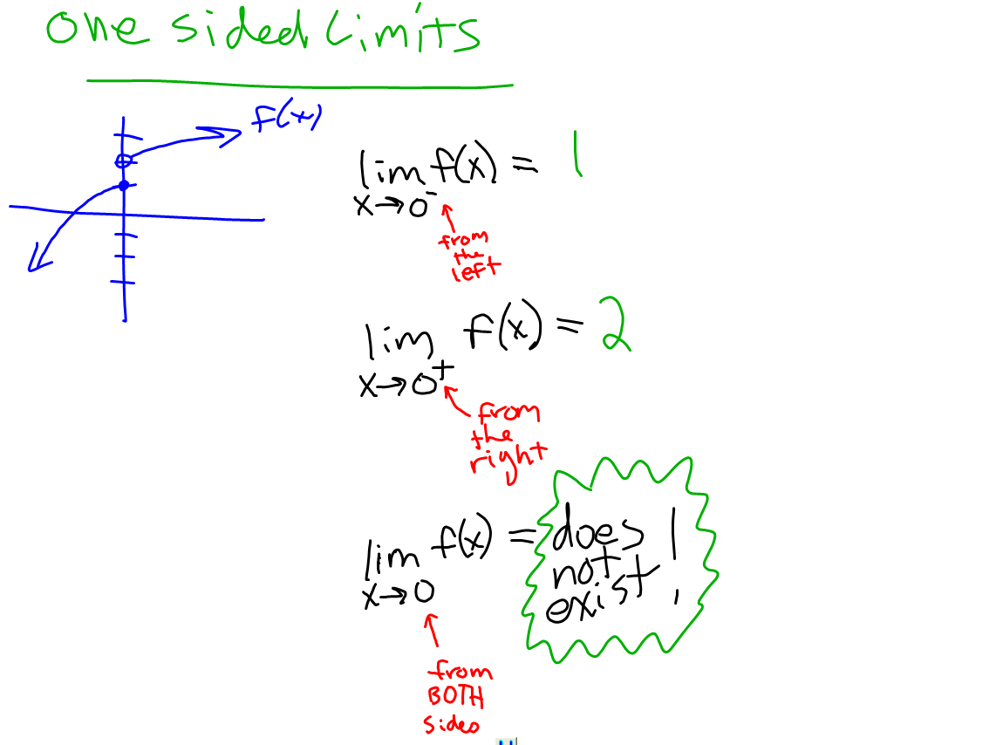

Slide 4
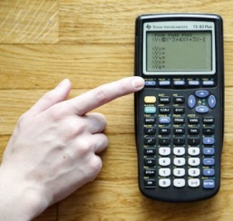
Techniques for Evaluating Limits
1. Direct Substitution (if appropriate)
If direct substitution yields an “indeterminate form” like 0/0…
2 . Remove the discontinuity (hole) by cancellation
Ex. $\lim_{x→2}{\frac{x^{2}−4}{x−2}}$
3. Remove it by rationalizing or other algebraic methods
Ex. $\lim_{x→0}{\frac{\sqrt{x+1}−1}{x}}$
4. Analyze an absolute value by setting up two cases
Ex. $\lim_{x→4}{\frac{\left|x−4\right|}{x−4}}$
5. If the discontinuity can’t be removed, use your calculator to approximate the limit by interpolation (plug in values that are very close on either side and average them!)

Slide 5
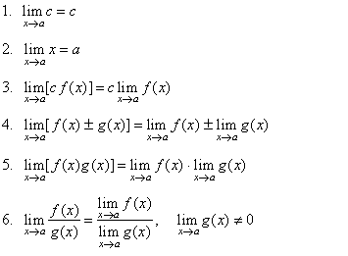

Properties of Limits
Random fact: $$\lim_{x→0}{\frac{sinx}{x}=1}$$

Slide 6
Limits at Infinity
If f(x) gets as close to a number L as we please when x gets sufficiently large, then…
similarly…
This occurs when y = L is a _______________
HORIZONTAL ASYMPTOTE

Slide 7
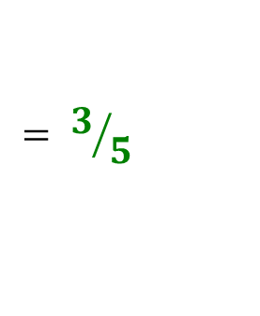
Limits at Infinity → Think “End Behavior” & “Horizontal Asymptote!”
Graphs on Geogebra!
$$\lim_{x→∞}\left[\frac{2x^{2}+7}{3x^{3}−5x+2}+\frac{3x^{2}+1}{5x^{2}−7}\right]$$
$$0$$
$$+$$
$$3/5$$
$$= 3/5$$
Limits at Infinity & Infinite Limits
$$\lim_{x→∞}\left[\frac{x^{4}+7}{x^{3}−4x+1}\right]=$$
$$\lim_{x→−∞}\left[\frac{x^{4}+7}{x^{3}−4x+1}\right]=$$
$$∞$$
$$−∞$$
Since the numerator dominates, this has no horiz.asy. It is “unbounded” (No Limit!) …but where is it heading? .
As we approach $−∞$, this function would produce a big negative in the denominator, and an even bigger positive in the numerator.
To infinity!
Since $\frac{+}{−} = −$, the function will approach $−∞$

Slide 8
Infinite Limits continued…
$$\lim_{x→3^{+}}\left(\frac{1}{x−3}\right)=$$
$$∞$$
Explore the limit numerically (with a table)
Explore the limit graphically
x | y
5
4
3.5
3.1
3.01
½
1
3
2
10
100

Slide 9
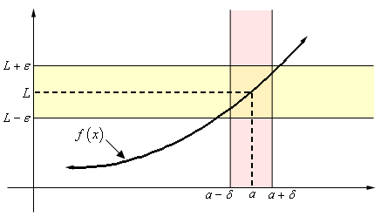
The Formal Definition of a Limit
We define $\lim_{x→c}{f\left(x\right)}$ to be the number L (if one exists) if for every $ε>0$ there is a (sufficiently small)$δ>0$ such that if $\left|x−c\right|<δ$ and $x≠c$, then $\left|f\left(x\right)−L\right|<ε$
$$c−δ c c+δ$$

Slide 10
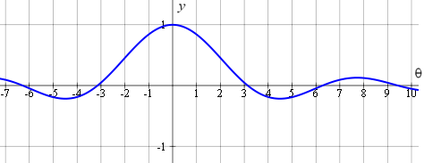
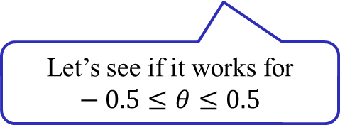
Ex.2 By graphing $y=\frac{sinθ}{θ}$ in an appropriate viewing window,
find how close $θ$ should be to 0 in order to make $\frac{sinθ}{θ}$ within 0.01 of 1.
1.01
1.01
1
1
0.99
0.99
-0.5
0
0.5
-0.2
0
0.2
Nice! We can see that if $θ is within 0.2 of 0$, then $\frac{sinθ}{θ} is within 0.01 of 1.$
Nope! Some y-values are more than 0.01 units from 1
Let’s see if it works for $−0.5≤θ≤0.5$
Let’s revise and try again!

Slide 11
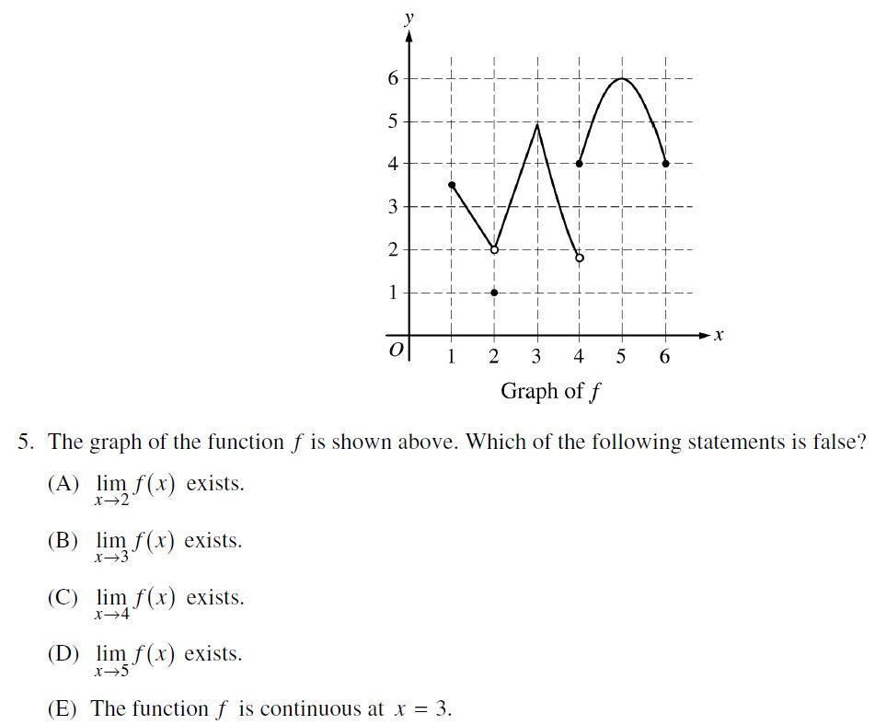
C
ANSWER

Slide 12
B
ANSWER

Slide 13
C
ANSWER
A
ANSWER

Slide 14
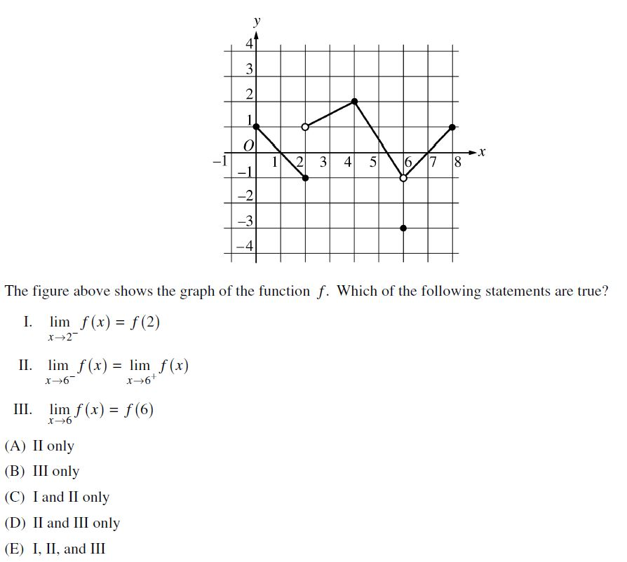
C
ANSWER

