Slide 1
Lesson: _____ Section 1.5 Review of Trigonometry
Triangle
Measurements
10
5
1 rad.
2 rad.
5
5
The radian measure of a central angle θ
=
arc length
=
s
radius
r

Slide 2
Radians | Degrees
360°
1 full revolution?
½ a revolution?
180°
¼ a revolution?
90°
60°
s
=
θ
45°
r
30°
or $s=rθ$ which is called the arc length formula
2
?

Slide 3
Sketch the following angles:
Ex.

Slide 4
Imagine a real number line is wrapped around the unit circle.
Each real number t on that line corresponds to a point (x,y) in the coordinate plane.
y
t
x

Slide 5
(x, y)
Remember:
“SOH CAH TOA”
1
t
y
t
x
The Six Trigonometric Functions
Reciprocal Functions

Slide 6
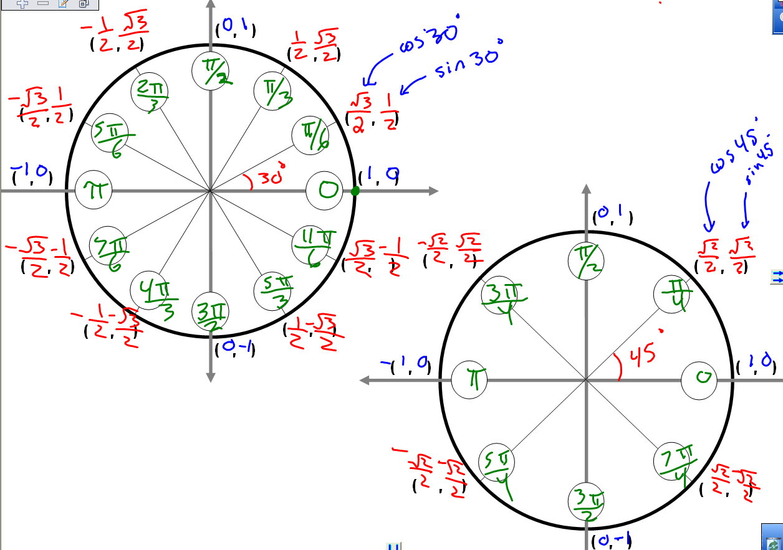
Evaluating Trig Functions
Unit Circle!

Slide 7
Evaluate! (Remember to be “A Smart Trig Class!”)
Memorize!
 | 30° | 60° | 45°
sin
cos
tan

Slide 8
Graphing Trig Functions
$$y=sinx$$
$$y=cosx$$
$$y=tanx$$

Slide 9
To graph sin and cos: Find _____________________
To graph tan and cot: Locate ___________________
To graph sec and csc: First ______________________
Graphing Trig Functions
the amplitude & the period
period = 2π/b
the asymptotes
for tan → set the input = -π/2 and π/2
for cot → set the input = 0 and π
Graph cos or sin, then use that graph to locate the asymptotes and max/min points
Given a trig graph, how do I organize my work to come up with the equation?
Write down the generic model y = d + a sin b(x-c) then set up a=__ b= __ c=__ d=__

Slide 10
y = d + a sin b(x – c)
Vertical SHIFT
up(+) or down(-)
Vertical Stretch/Shrink by a factor of a
AMPLITUDE = |a|
negative a values:
vertical reflection over x
Horizontal Stretch/Shrink
PERIOD =
Horizontal SHIFT of c units
y = 1 + 2sin 3x

Slide 11
Write the equation of the given function!
5
- 8π
8π
– 4
y = d + a sin b(x – c)
Write down the generic model
then replace all unknown constants with numbers!
a =
b =
c =
d =

Slide 12
Inverse Trig Functions
What is the angle whose sine is ½ ?
ex₁: ex₂:
ex₃: ex₄:

Slide 13
Trig!

Slide 14
Next Day Review Problems
5
-π
π
– 4

