Slide 1
Lesson: ____
Section: 1.3
New Functions from Old
1. Transformations
2. Combining Functions
3. Odd & Even Functions
B. Inverse Functions

Slide 2
Graphing transformations of functions
Vertical & Horizontal Shifts of y = f(x). (any function)
1. Vertical shift c units upward h(x) = f(x) + c
2. Vertical shift c units downward h(x) = f(x) – c
3. Horiz. shift c units to the right h(x) = f(x – c)
4. Horiz. shift c units to the left h(x) = f(x + c)
Reflections of y = f(x) (any function)
1. Reflection in the x-axis h(x) = – f(x)
2. Reflection in the y-axis h(x) = f( – x)
Vertical Stretches of y = f(x) (any function)
h(x) = c • f(x)
“Vertical Stretch by a factor of c”
(if c > 1) → stretches ( if 0 < c < 1 )→compresses

Slide 3
1. y = ½ x²
1. Stretch vertically by a factor of 1/2
Run Geogebra
2. y = -|x|+3
1. Reflect over x-axis 2. Shift up 3
See 2.1 adjustable parabola (if time)
3. y = (-x+2)³
Shift left 2
Reflect over the y-axis
4. y = √-x +3
1. Reflect over the y-axis 2. Shift up 3
5. y = 2(|x-2|+3)
= 2|x-2|+6
1. Shift right 2 2. Stretch vertically by a factor of 2. (multiply all output values by 2)
3. Shift up 6

Slide 4
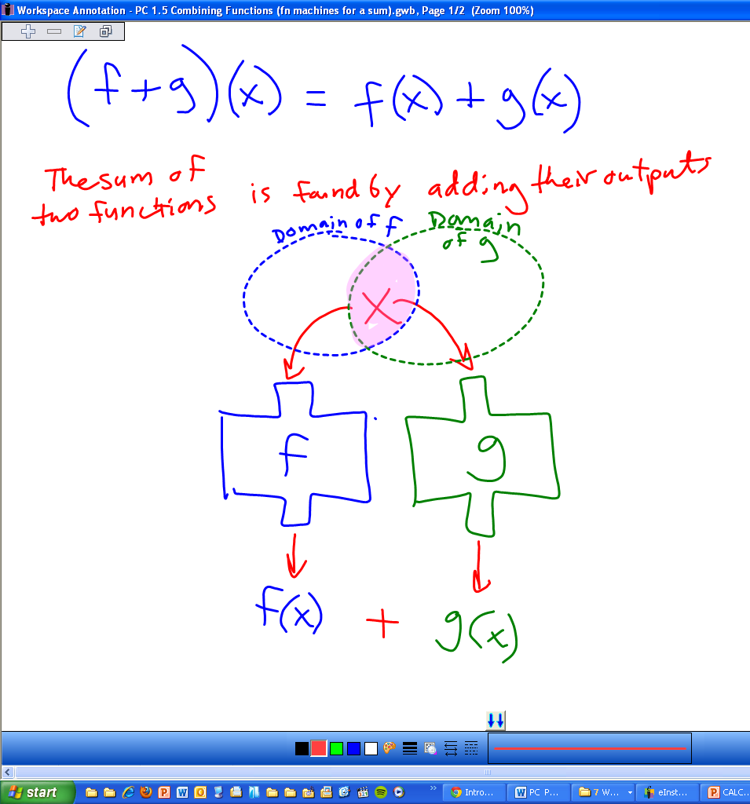
Combining Functions Arithmetically (+, -, x, ÷)
Run Geogebra
See 1.5 adding functions

Slide 5
Domain of f
Composition
x
of functions
input
In Range of f
and Domain of g
Function
output
f(x)
f
input
Range of g  f
g(f(x))
Function
output
g(f(x))
g

Slide 6
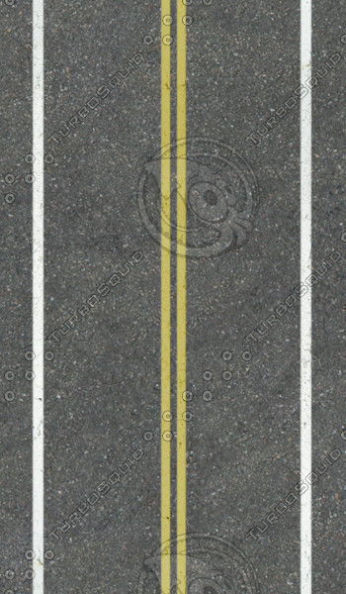
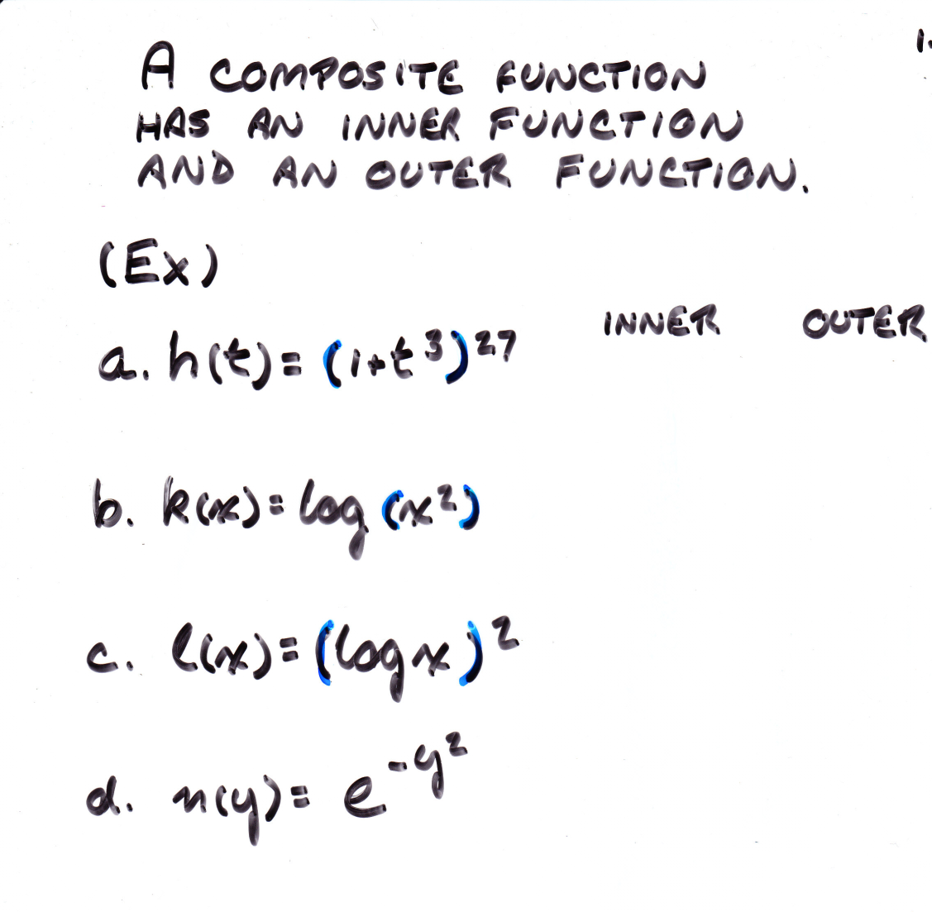
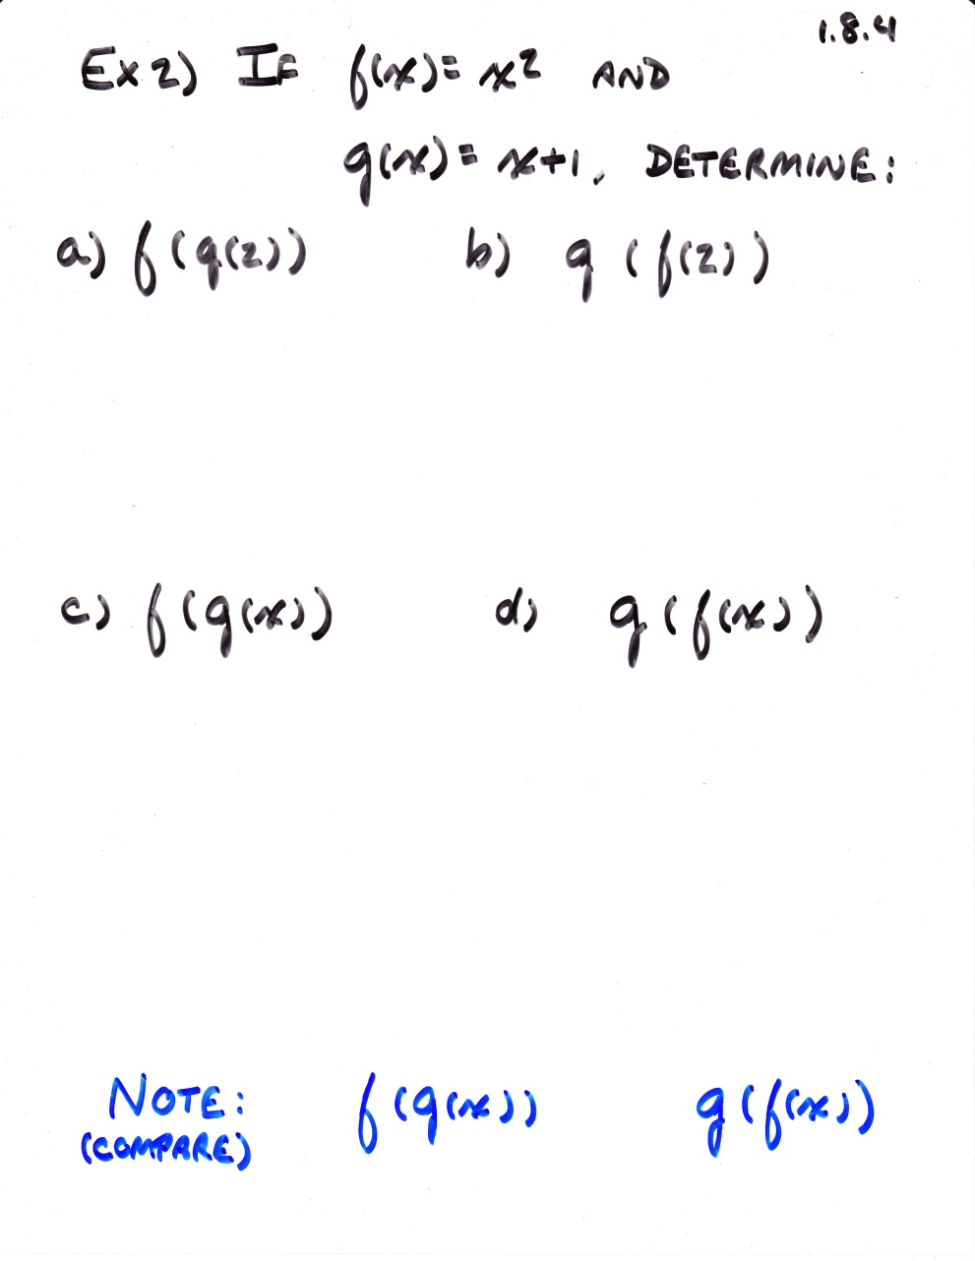
Composing Functions

Slide 7
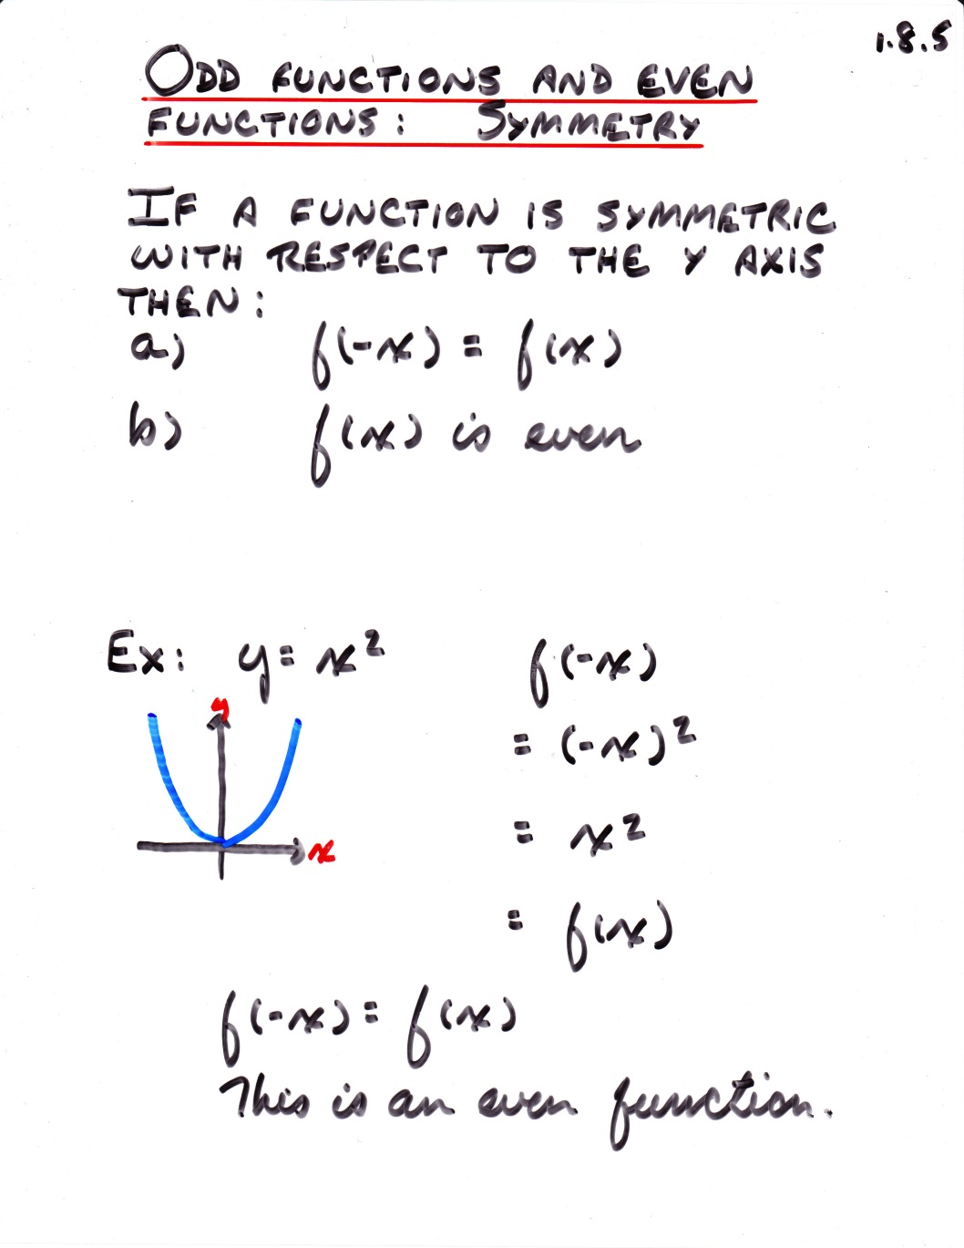
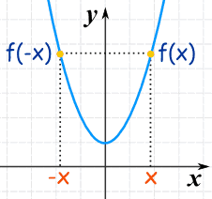

Slide 8
Inverse Functions
d
$$f$$
t
t
$$d=f(t)$$
$$f^{−1}$$
t
d
d
t$=f^{−1}(d)$
Ex. d = 10t
{(1,2), (3,5), (8,7)}
$$f\left(x\right)=2x−5$$
$$f^{−1}\left(x\right)=\frac{x+5}{2}$$
Here the input & output are generic, so we can graph them both on an input vs. output graph.
Note that this is the same relationship just proceeding in the opposite direction. The only difference is which quantity is being considered the output (dependent) and which is the input.
So to describe the inverse of a one to one function, we simply interchange the role of input and output.

Slide 9
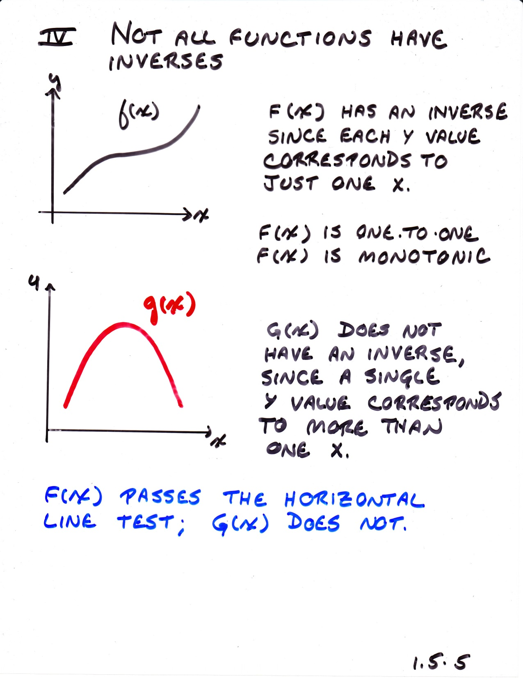

Slide 10
