Slide 1
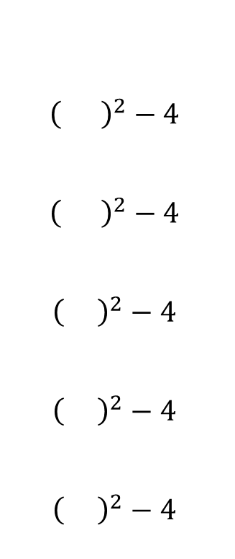
Lesson _____ Section 3.5
Graphing Square & Cube Root Functions
Review: Graphing by POINT-PLOTTING
Graph a bunch of points and connect the dots!
Ex. Graph the function $y=x^{2}−4$
$${\left( \right)}^{2}−4$$
$${\left( \right)}^{2}−4$$
$${\left( \right)}^{2}−4$$
$${\left( \right)}^{2}−4$$
$${\left( \right)}^{2}−4$$
$$x$$ | $$y$$
-2
-1
0
1
2
$$−2$$
$$−1$$
$$0$$
$$1$$
$$2$$
0
-3
-4
-3
0

Slide 2
$$x$$ | $$y$$

